Slide 1
How to Read A lease agreement
Because you have rights too!

Slide 2
Introduction
This is a contract
The landlord has certain rights, but so do you
While it may be scary to sign your name, a lease agreement protects you too
Make sure you understand what you’re signing

Slide 3
What exactly is a lease agreement?
It determines how long and under what conditions you will live there
It lists amenities that are included, like utilities, internet, or lawn care
It outlines your accepted rent payment, methods of payment, and who to pay
By signing your name, you become legally bound to obey the lease agreement

Slide 4
Checking out the rent
First, make sure the rent payment is what you expect
DO NOT MAKE HANDSHAKE DEALS THAT VARY FROM THE LEASE AGREEMENT
Make sure sure that the method of payment is acceptable.
  Is it by check?
  Do they expect direct payment from your bank?
  Can you use a debit card online?
Check the due date
  First of the month?
  Last day of the month?
  Date from signing?

Slide 5
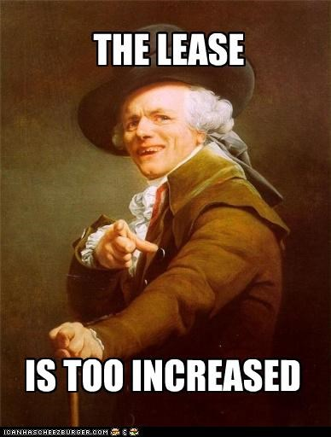
What about deposits, fees, and extra rent payments?
You will not pay rent, and rent alone
There are extra monetary things that you’ll be required to pay before you’re allowed to move it.
There are also additional fees that you must pay for late payments or other such things

Slide 6
Security Deposit
You’ll be required to pay a security deposit
Just like how rent varies from location to location, so does the security deposit
You pay a security deposit, but you get it back when you move, provided you do not damage the apartment
Security deposits are paid before you are permitted to move in

Slide 7
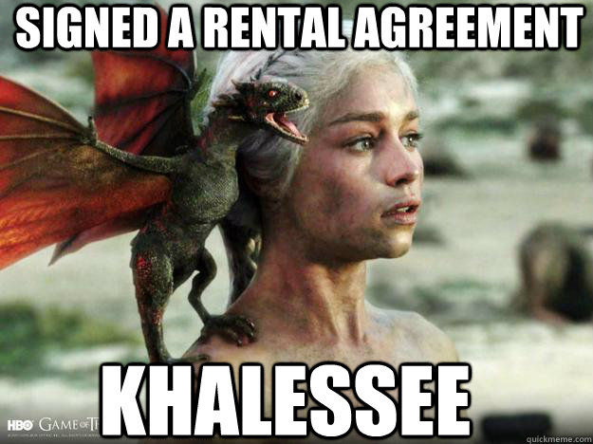
First and Last month’s rent
Many locations require you to pay first month and last month rent before moving in. This prevents loss for the landlord should a tenant leave quickly
Make sure you consult the lease about last month’s rent so that you’re not charged double when you decide to move out

Slide 8
Fees
You can accrue late fees by not paying your rent on time
Check your lease agreement to see what those fees entail
There is no state regulation on how much a landlord can charge

Slide 9
Utilities
Sometimes utilities are included in your rent
You are entitled to your own electric, gas, and water meter
You legally do not “split the utilities” with other apartments
Be careful with whose name goes on the utilities when roommates split them
If your roommate won’t pay their fair share, the utility company will demand that the other roommates pay, or they will be shut off

Slide 10
Lease Renewal
You are entitled to live in the rental for the specified amount of time, provided rent is paid regularly and on time
At the end of the period, the lease is renewed
Rent may increase upon renewal
Other changes may be made, such as the payment date, permitting pets, or what amenities are provided

Slide 11
pets
Many rentals do not permit pets
Therapy, service, support, and other such animals are an exception
You may still be required to pay a pet deposit depending on the situation
Check with your landlord and be prepared to provide the necessary documents that would qualify your pet

Slide 12
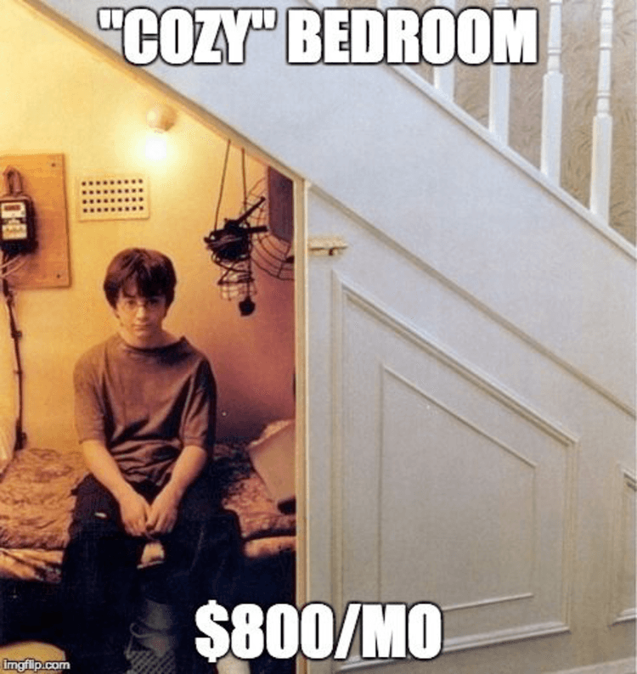
Breaking the lease
Sometimes you must move out early
Be sure to read the agreement about the penalties
Sometimes, you will need to pay the rest of the rent that would have been collected in one lump sum
Sometimes, you will pay a percentage of what you would have had to pay
Some lease agreements allow you to sell your contract to someone else

Slide 13
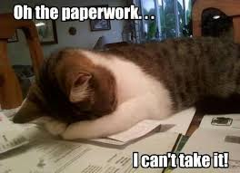
What in the world is the benefit?
You have rights!
If an appliance breaks that is included in the lease, the landlord must fix or replace it
The landlord must keep the residence up to code and safe
The landlord cannot evict you without going to court
The tenant has the right to have proper notice before a landlord enters the rental
A landlord may not take property in order to collect rent
A landlord cannot turn off utilities to coerce rent payment
A landlord cannot evict as retaliation for a tenant demanding a safe living condition

Slide 14

Nice. And if the landlord is a jerky jerk face anyway?
You have legal recourse
These phone numbers can put you in touch with people who have the authority to take action against cruel or negligent landlords
Call the Attorney General office to report a landlord
Call the Legal Aid office if you have an eviction notice
Just because you’re served with paperwork does not mean your landlord has a case

Slide 15
But Who Signs?
If you are signing up with roommates, all of you need to sign the agreement
The road of roommates is littered with shattered friendships because someone was irresponsible with paying rent
If someone who is not on the lease walks away, everyone else must still pay full price for rent
If you all sign the lease, then you may be in a position to negotiate. At the very least, the person who walked away will pay the penalties for breaking their part of the lease.

Slide 16
So, you signed
Congrats on the keys!
Take pictures of every inch of the apartment
  This prevents your landlord from keeping your security deposit for previous damage
  This will also help in case of catastrophe like busted pipes, fire, sewage backup, or a stray honey badger that wants your pizza rolls
Keep these photos in case of renters insurance claims

Slide 17
Wait! Renters whoosa whatsa?
Just like your car, cellphone, and hey, life, you have renters insurance
If you have expensive electronics like gaming systems, laptops, or a TV, you may want to consider renters insurance
On average, renters in West Virginia pay $15 a month for insurance
This typically covers theft, natural disasters, or freak accidents (the light fixture on the ceiling crashes down on your laptop)
Make sure that you purchase enough insurance to cover your possessions
Taking before photos will help you to file your claims with your nasty after photos

Slide 18
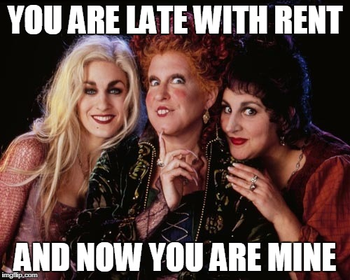
Pretend for a moment that rent is past due…by five months
You signed a legally binding document
This can affect your credit score, your ability to rent in the future, your ability to qualify for loans (like for a car), and your school enrollment if it’s school housing
This is very difficult to get out from under

Slide 19
Just for funsies
Benefits of renting
Benefits of buying
Freer to move from home to home
Ideal for people who are not planning to stay long in one area
Landlord repairs broken appliances
Landlord responsible for keeping to code
Will one day no longer pay a mortgage
Can use paid amounts of the loan to leverage future loans (another presentation for another day)
No one walking above your head in combat boots at 2AM
You can have whatever pets you want
Probably better parking. Probably.

Slide 20
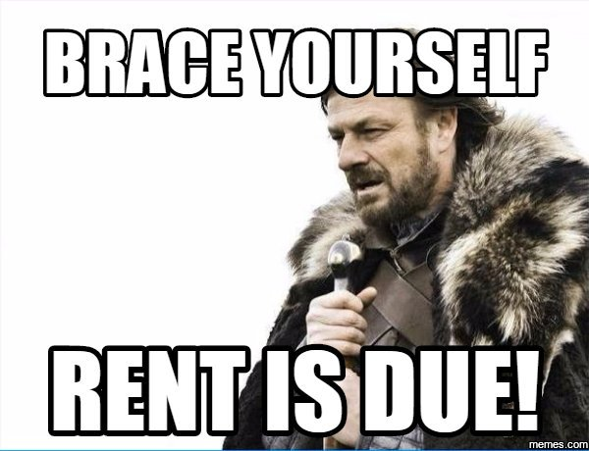
Overwhelmed?
Ask a trusted person who has experience with renting to review the lease with you
Come to the library for information about precautions and rights
Talk to the school’s housing department for uncertainties in the lease for dorms or other school housing

Slide 21
Congratulations!
You now understand rent and lease agreements better than most people who show up on tv court shows

