Slide 1
Business Communication

Slide 2
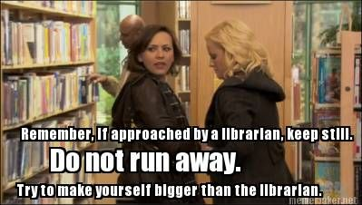
A little bit about my office
My favorite part of my job is helping with research
I’m a student too, and I get the whole research deal
I have plants in my office you can garden
You can talk to me about your cruddy day
My office is Safe Fortress 3.6TM
Notes:
.

Slide 3
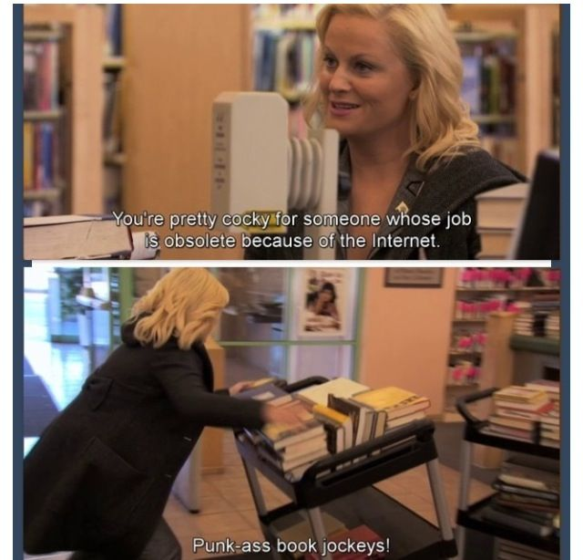
Confidentiality
I believe in student confidentiality, and I’ll work hard to protect it
Unless attendance is required for an assignment, I do not tattle to your professor about if or when I help you
I can help you store books that you aren’t safe to bring home
I have only broken confidentiality once
Apparently, my threshold is perpetuating a class 4 felony

Slide 4
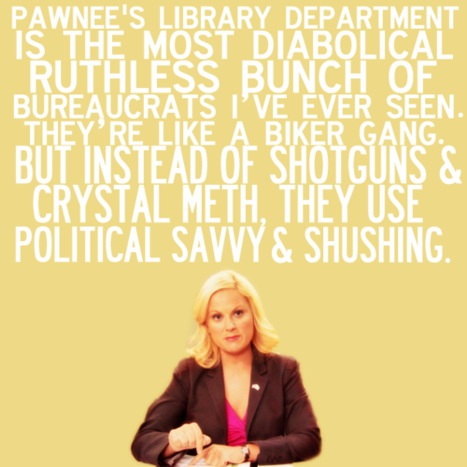
When to come for help
Anytime. From the very beginning with looking up a topic to the last minute before it’s due
I don’t lecture you if it’s last minute. We both know it’s a last-ditch effort
I’ve slid in under the wire myself with a big enough sigh of relief to launch a sailboat

Slide 5

Databases aren’t like google
Their search algorithms are much older
They’re not intuitive
You have to be very deliberate and specific about your search terms
They require login credentials

Slide 6

Why Can’t I Just Google Things?
I bow to the prowess of young adult sleuthing skills
  Ya’ll are terrifying
Big Data is smarter though
Copyright law
Paywalls are getting more extreme

Slide 7
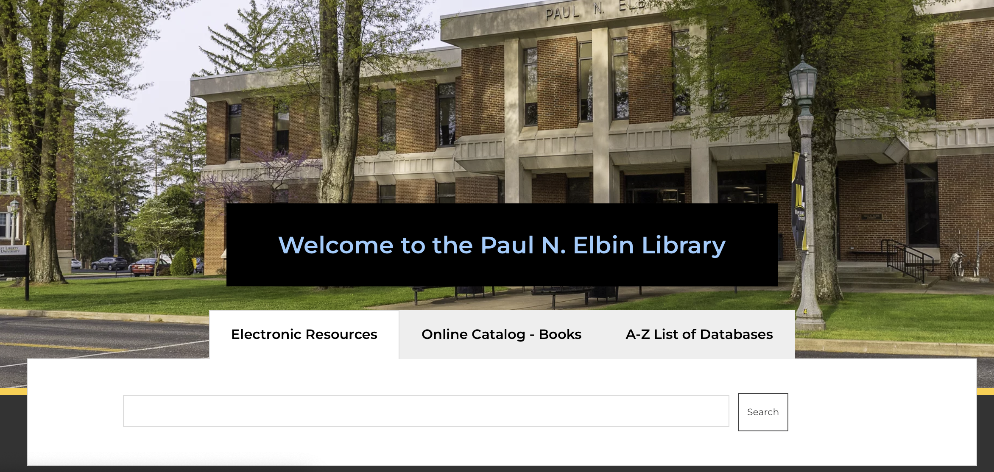
Library Webpage

Slide 8

How to enhance your search
For the overachievers in the room
Notes:
Enhancing your search is a great way to make sure that the best results for your query comes to the top. No one wants to go through pages and pages of results to try and find something that works.

Slide 9
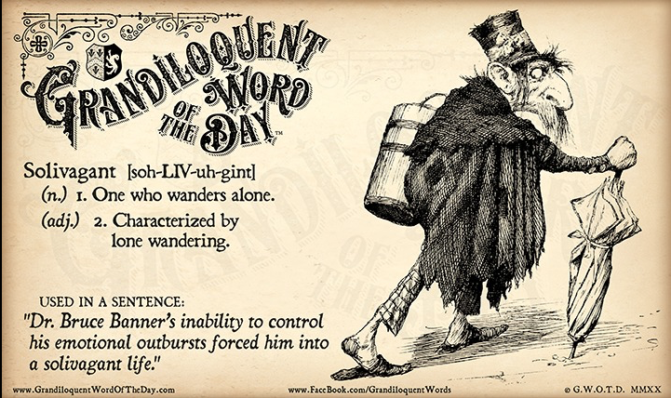
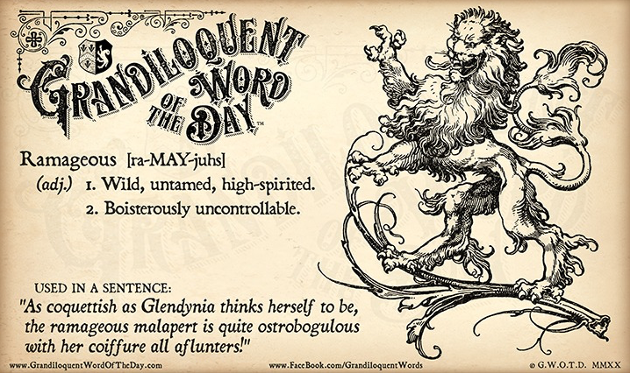
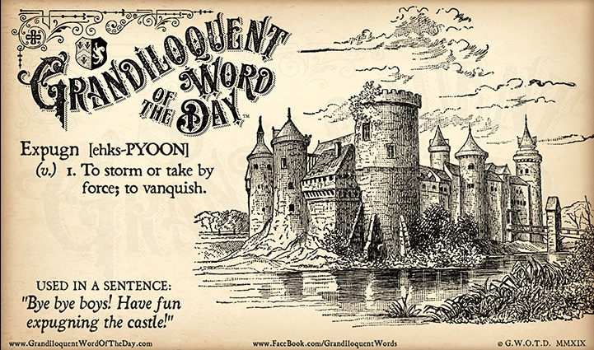
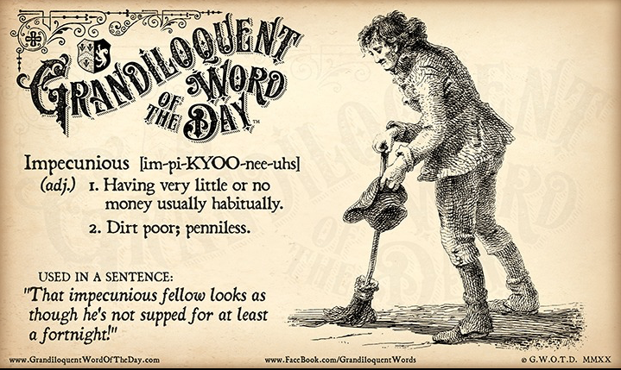
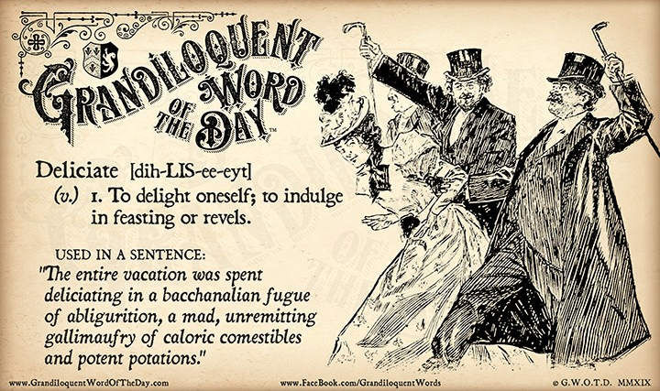
Use Your Big Kid Words
Used with permission
Notes:
I can't stress this enough: You've got to use the big kid words. Every major, program, and profession has its own terminology that is specific to it. This terminology serves as a way of communicating ideas in a direct manner. You need to make friends with these words because they will determine the outcomes of your searches.

Slide 10
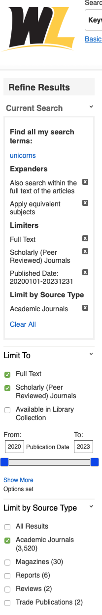
Behold the side bar awesomeness
Make sure to click “Full Text”
Select “Scholarly (Peer Reviewed) Journals
Make sure the dates are set to current trends
Check “Academic Journals”
Always click “full text”
This is the research your professors want
Be aware of your research expiration date
Academic journals are safe sources
Notes:
Behold the side bar awesomeness! While it's nice to see that there are over 100,000 search results, there's no way you can sort through all of those articles to find the best ones. This side bar will help you to narrow down your results. By clicking on "full text," you'll have access to the entire article. Click on scholarly (peer reviewed) journals. You'll need to adjust the publication date to one that is acceptable to your program. Each program has an "expiration date" for research that is out of date. If you're in a medical program, you'll need to make sure your research is no older than 3 years. For all other programs, you're looking at five years. Finally, click on the academic journals under source types. This combination of clicked boxes will give you results that your professors would accept as "citable."

Slide 11
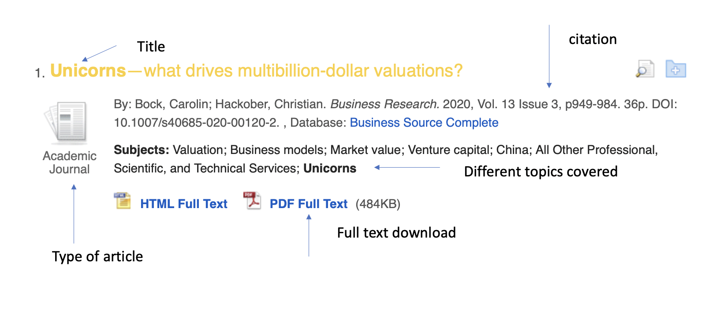
Search Result citation info
Notes:
This is what a search result looks like. The yellow is your title. Below it is a citation that is loosely based on APA. This definitely should not be used as your final citation. It’s pretty much gibberish to people who know what a citation should look like. Business Source Complete in blue is the database that this article is from. The icon on the left indicates that this is from an academic journal, which means that it's scholarly. The PDF Full text in blue is where you download the article.

Slide 12
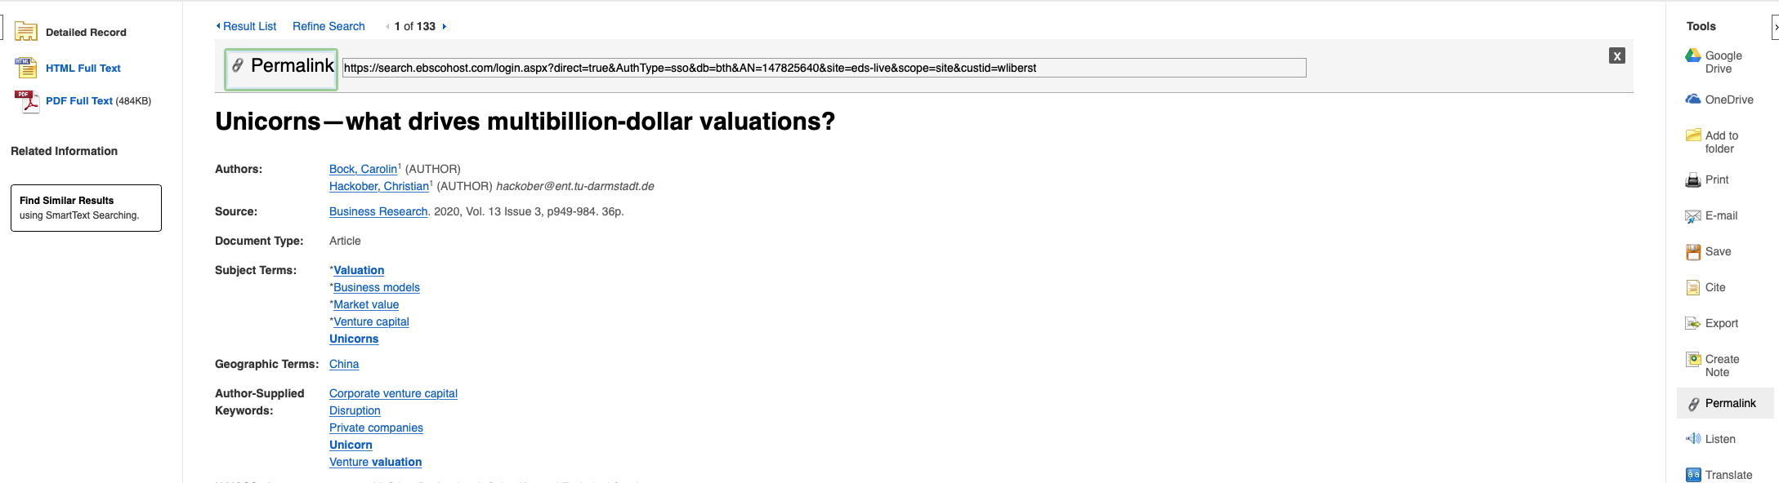
Article Breakdown
Notes:
This is what it looks like when you click on the article. From here, you can download the article on the left. You can save your article to google drive. We're a gmail school, so you have storage built into your school email. These articles are tiny in size, and they won't take up much space. I recommend saving whatever you even might need into this drive, especially if you’re using our library computers. Besides, you never know when you’ll be able to use those articles again in a future assignment.
At the bottom, you can select the permalink. Any time you need to use a link, you need to use the permalink. Otherwise, you'll only send the link to the search results. The permalink will pop up at the top of the article title. If you don’t select the permalink option, it won’t be there.

Slide 13
Wait! I need more help!
I thought that I was ok, but I’m not.
Notes:
Once again, I’m not going to shame you for coming in at the last minute. Sometimes, you think you’re doing ok. You think you’ve got a handle on things. Then, you dive more deeply into the assignment and realize that you’re in big trouble. Been there. Done that. You have my empathy.

Slide 14

You are the rock star
Unless I am in a meeting, everything stops when you come to my office
Ask for me at the reference desk. They can point out my office. (You don’t even have to know my name)
HOWEVER! You are not required to come to my office in person.
I read your emails as soon as I can.
Your homework hours are not traditional business hours, but I’m limited in the evening
Notes:
When you reach out to me for help, you're the rock star. It can be in person, or through email. When I'm at work, I stop whatever I'm doing to answer research questions. When I'm off duty, I'll still answer emails and send information whenever possible. I might not be as quick or able after hours, but I do give it a try. I love assisting with research, and I'm ready to help.

Slide 15
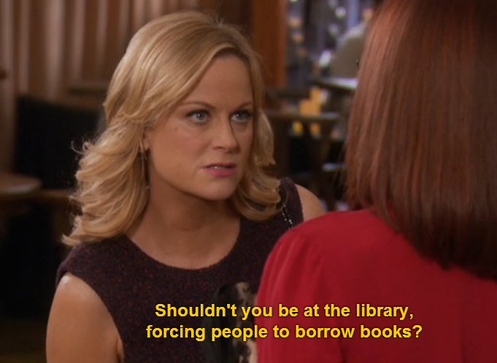
What if you came to the library for help, and the articles ended up not being useful?
It happens!
Research is a cycle
We will find new articles
It won’t hurt my feelings if those articles didn’t work out
Come back as often as you need
Notes:
It does not hurt my feelings at all if you need more research or a different direction. If what I gave you isn't working out, then I'm happy to do additional research. Research is a cycle, and I respect the cycle. Feel free to reach out as often as you need.

Slide 16

Citing your articles
Plagiarism is sort of a big deal.
Notes:
Plagiarism is a big deal. Citations are a huge part of your paper, and your professors expect that they will be done correctly.

Slide 17
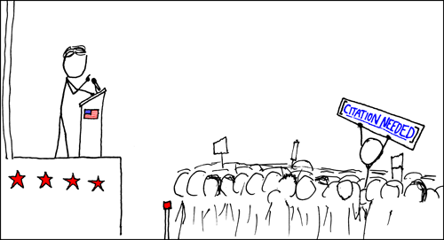
Citations
Cite your sources or face some consequences
Failure to cite is plagiarism
Plagiarism can cause you to fail an assignment or even fail the class
If you’re stuck, I will email you the proper citation format
Credit: Randal Munroe “XKCD”
Notes:
Cite your sources or face some consequences
Failure to cite is plagiarism
Plagiarism can get you kicked out of school.
I know that citations give students quite a bit of anxiety and headache. If you're stuck, you can email me to look over what you have, or I can give instructions for how to cite something. It’s not worth failing the assignment that you put so much effort into.

Slide 18
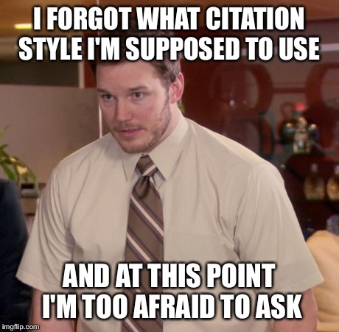
How would your professor even know…
It’s obvious when you’re synthesizing someone else’s idea into your paper.
You go from sounding like a freshman, to a grad student, and back to a freshman
There are too many factors to try to change to sound like you
You don’t want to have that awkward conversation
Notes:
It’s pretty obvious when you’re plagiarizing. You go from sounding like an undergraduate student, to a professor who likes to walk their terrier in parks during a New England autumn, and then you go back to sounding like an undergraduate student. There are too many factors that you’d have to take into consideration for you to sound like you when you’re stealing (yes, stealing) from someone else. It’s an awkward conversation when you get caught, so do yourself a favor and just cite your sources.

Slide 19
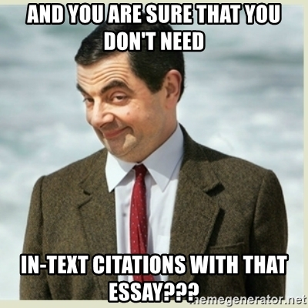
Citations done! Right?
I did the things! All of my citations are done, nice and neat, resting comfortably at the end of my paper. All done.
Or not.
Because there are in text citations.
Notes:
In text citations are just as important as the ones you put at the end of your paper. Your professors expect them, and they take them seriously.

Slide 20
Story Time…
Once upon a time, I had a student ask me to check her end references. I was a young, idealistic librarian, full of hope, and I didn’t think to check her in text citations. She failed her paper because she didn’t have any. Her professor informed her that only failing her paper was an act of mercy. She was told that she should have been reported for plagiarism.
The End.
Notes:
Make sure you have those in text citations lined up and ready to go. If you need help, I can help.

Slide 21
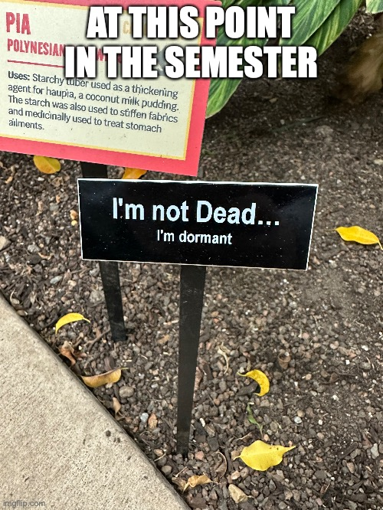
Important Note
I don’t expect you to memorize the following slides
They’re there for your benefit if you download the presentation
They act as a reference point or a guide for when you’re actually doing your homework. I’ll show you how to download later.
Hang in there. It’s going to go fast.
Notes:
Students can easily get confused when they look up how to cite something on the internet. Maybe there’s a conflict from one website to another. Maybe one website uses two variations in the same example, and you’re not quite sure what’s the original format and what’s a new variation. Here are some reference slides that show you all of the variations, but only one at a time. It’s all color coded, and I take into account the most popular things that you access: journal articles and websites.

Slide 22
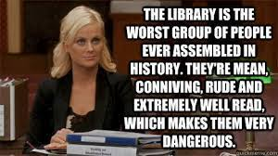
Journal Articles for the Win!
Notes:
Here we go. Remember, you don’t have to memorize these slides, and I’m going to get through them pretty quickly.

Slide 23
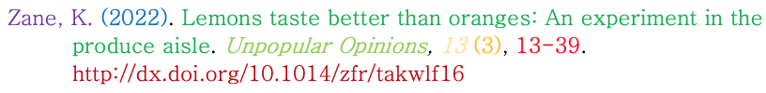
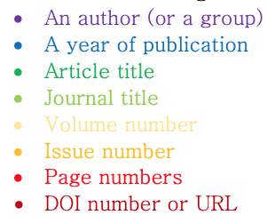
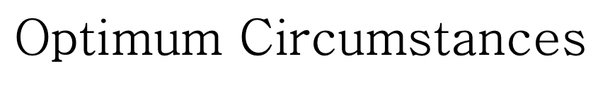
APA Style Guide
You’ve got all the stuff, and this is all where it goes. Tucking in the crazy one comma at a time.
Notes:
If the world were right and good, this is what your citation would look like for a journal article in APA style.

Slide 24
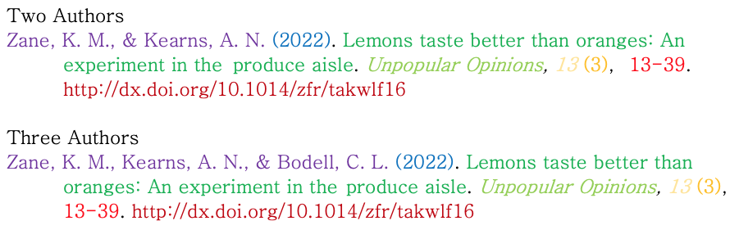
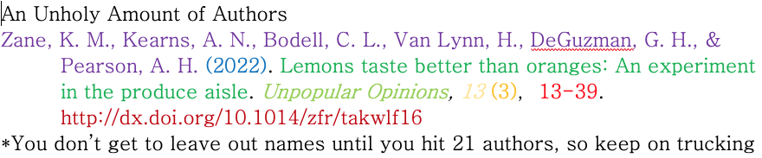
Authors
Notes:
These slide shows you how to handle your author variations

Slide 25
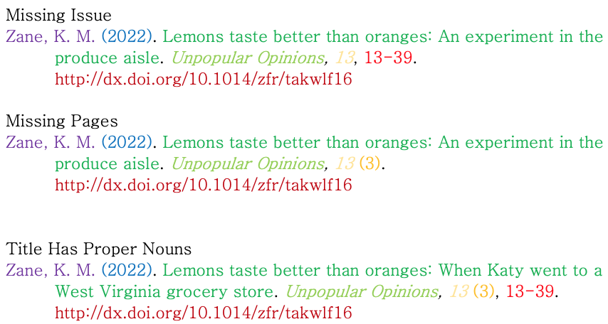
Less than optimal citations
Notes:
This slide shows you how to deal with things that are missing from your article

Slide 26

Websites Are Great!
Notes:
Websites are an awesome source of knowledge, but they can be more difficult to manage citation-wise than journal articles through a database.

Slide 27
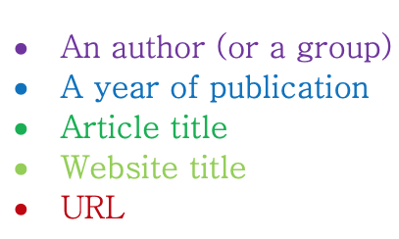

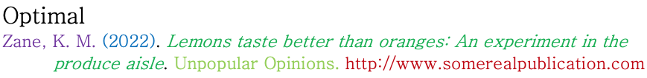
APA Style Guide
Notes:
APA is pretty straight forward. This example is if the stars align and everything is included on the page. But we know that usually doesn’t happen.

Slide 28
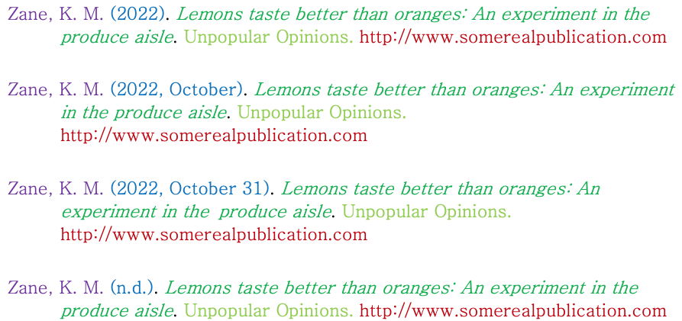
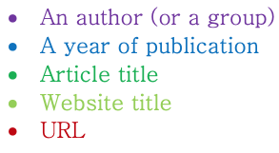
Date Variations
Notes:
Here are all of the date variations that you might encounter. Journal articles are easy. They only want the year. Websites are a different matter though. Anything that you can do to get complete date information is helpful.

Slide 29
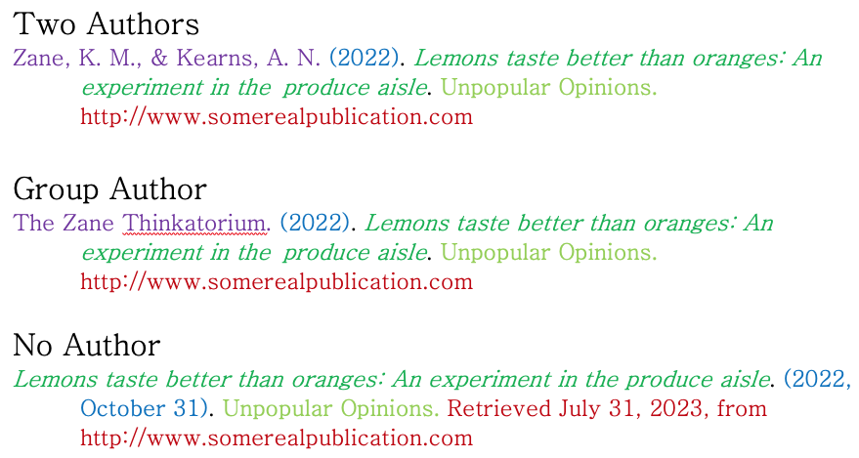
Authors and Groups
Notes:
Authors are also a little tricky on websites. Sometimes it’s an individual, sometimes it’s a group, and sometimes there is no author. If there is an author or a group, they tend to be at the top or bottom of the article.

Slide 30
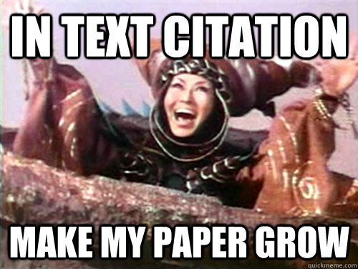
Free samples!
APA in text –
  (Author, year, p. page)
  (Zane, 2018, p. 3)
MLA in text –
  (Author, page)
  (Zane 3)
Chicago –
  Typically a footnote
  Zane admits that candy corn is gross¹
Notes:
Here are your in text citations for your paper. They’re pretty straight forward, but I can still give advice if there’s any problems. I can especially give some guidance about Chicago style. Not many professors use it, but if yours does, I’ll walk you through it.

Slide 31

Purdue owl
  This is a fantastic resource for all your citation needs. It goes through several different style guides
  If you get stuck, email me
  (It’s ok if you get stuck. I get stuck too.)
  https://owl.purdue.edu
Notes:
Purdue Owl is a great resource for your citations. It can be confusing sometimes, though. I understand. Don’t be afraid to ask if it’s getting under your skin.

Slide 32
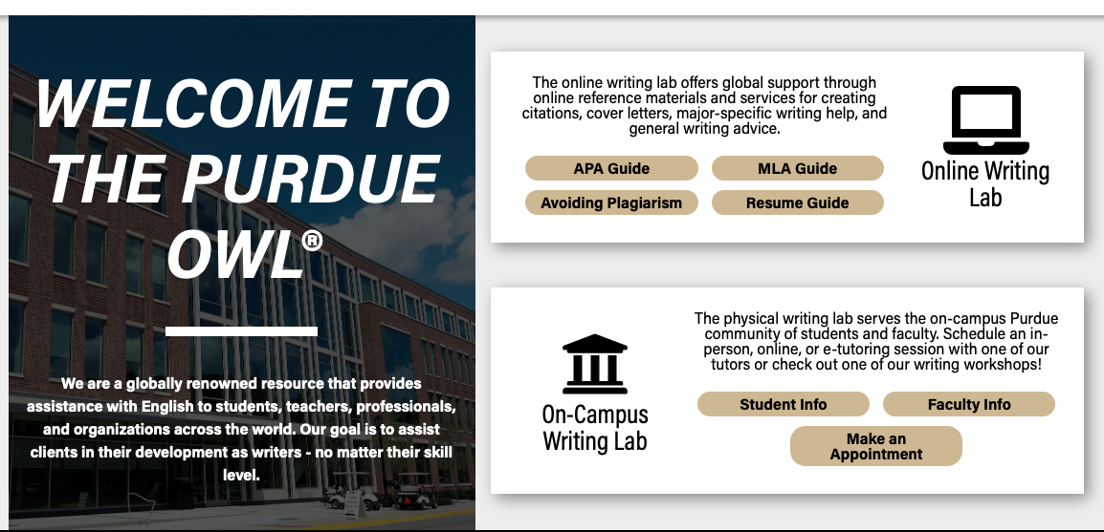
Purdue Owl Homepage
Notes:
This is the Purdue Owl homepage. Simply click on the style guide you need, and it’ll take you right to the citations page.

Slide 33
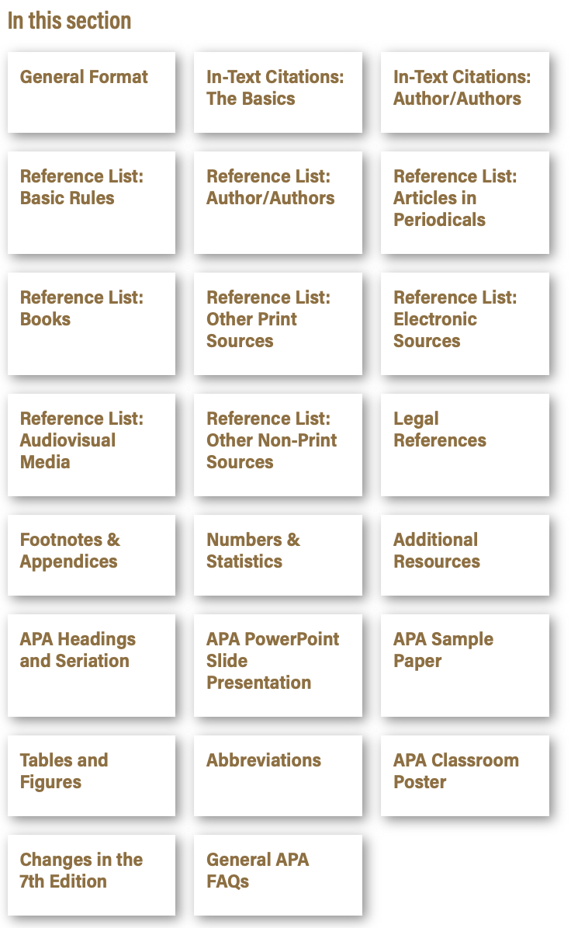
Citation Options
These are all the typical sources that people encounter when they conduct research
If you don’t find what you need, let me know because we may need to Frankenstein something together
Notes:
Here are most of the things that you’ll need to cite. Sometimes a source doesn’t fit neatly into one of these categories, and we may need to Frankenstein something together to make it work.

Slide 34
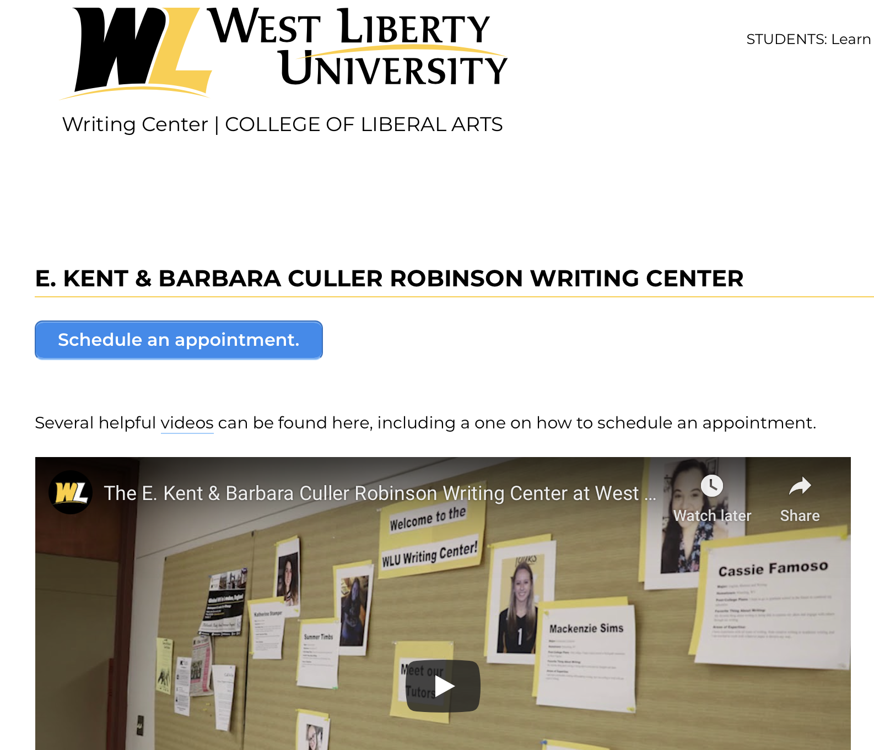

The Writing Lab
This is your best contact for help with your paper.
https://westliberty.edu/writing-center/
On their homepage you can schedule an appointment
They offer both online and face-to-face appointments
Notes:
If you do not feel confident in your writing ability, we do have a writing center. It's located in the basement of the library. You can schedule either digital or face-to-face meetings, and these people are good at what they do. They won’t tell you that your paper is stupid. They are great about pointing you in the right direction without making you feel bad about your efforts.

Slide 35
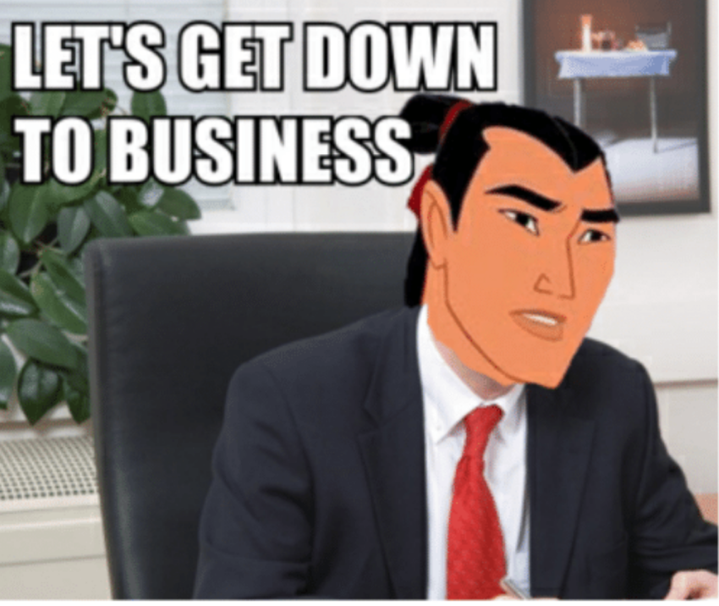
#FYC
(For your class)
Let’s talk about business communication
Options
  Verbal
  Written
  Interpretive dance (subject to situation)
  Body language

Slide 36
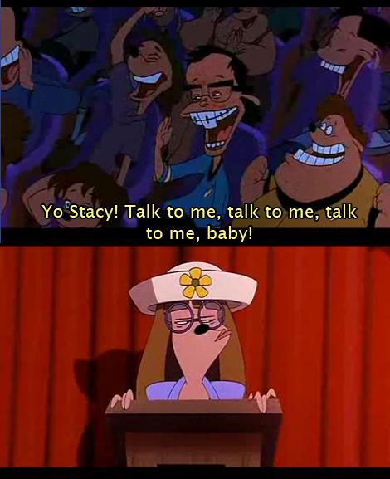
Verbal representation
Speak slower
We speed up when we’re nervous, or even when we know a lot about the information
Don’t be afraid of pauses between points
  Take a breath
  Allows the other person to comment
Lower your voice a pitch
  Our voice pinches when we’re nervous
  It helps with speed

Slide 37

Written respresentation
Sit on it for a moment
  Come back after a break, especially if you’re stressed
  A clear mind helps with editing
  It may or may not come from unfortunate experience...
Check for language and professionalism
Be aware of your audience
  Are you asking for something?
  Are you offering something?

Slide 38
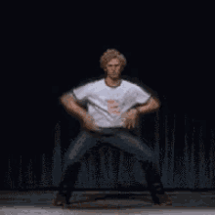
Interpretive dance

Slide 39
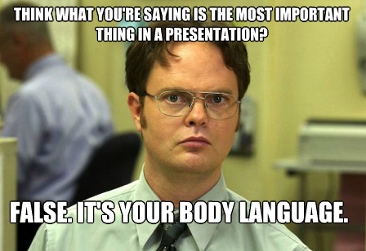
Body language
Deep breaths during your pause (not through the nose!)
Shoulders relaxed
Jaw relaxed
Watch the hand gestures
Offer or asking
  Slightly open hands for an offer
  Soft clasping for asking
Watch for fidgeting
Practice in front of a mirror
  Standing
  Sitting

Slide 40

Closing the deal
Thank them for their time, even if you feel like you wasted it
  Their pitch that failed (miserably)
  My pitch that succeeded (semi-bad)
Smoothly brush your hands against your pants
Firm handshake
Eye contact
Smile
Nod
Thank them one last time

Slide 41
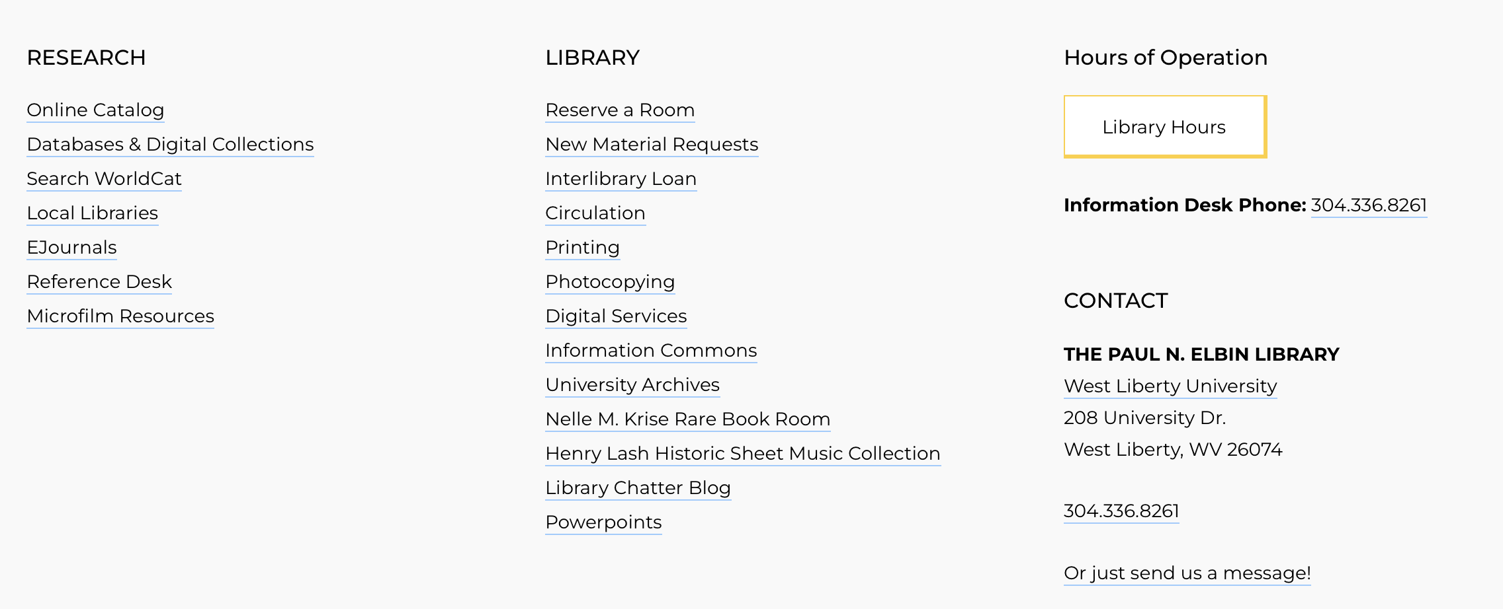
Download this super helpful guide!
Bottom of the page
Notes:
Obviously, if you’re listening to my dulcet tones, you’ve managed to find your way here.

Slide 42
How to contact me:
You can email me: Katy.zane@westliberty.edu
You can call: 304-336-8534
You can drop by my office. It’s back by the water fountain on the left.
I love reference questions! They make my day.
You are important. You are the most important people that I help.
Notes:
You can use the following methods to contact me. Email is probably the most effective way. I am working on recognizing interpretive dance as a means of communicating your research needs. You’re the most important people that I serve. I’ve worked with professors, university presidents, and I’m a state presenter for the West Virginia Library Association. None of that matters if I can’t help all of you. So, don’t be shy.

Slide 43
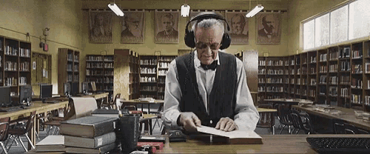
Go forward and make me proud
Notes:
Good luck on your future assignments! You can always reach out. You can always ask.

