Slide 1
Making Research Easy(ish)
Tips and tricks to make something a little more bearable.
Notes:
Hello! My name is Katy Zane, and I’m your librarian. I’m here to help you with your research and answer any other questions that you might have. Let’s get started, and we’ll make this as painless as possible.

Slide 2
A little bit about my office
My favorite part of my job is helping with research
I’m a student too, and I get the whole research deal
I have plants in my office you can garden
You can talk to me about your cruddy day
My office is Safe Fortress 3.6TM
Notes:
I love helping with research. There’s a satisfying feeling for me to see a student come to my office flustered by their assignment and have them leave with a sigh of relief. You’re not “bothering me” or intruding. You’re my top priority. I’m a student too, and I know what it’s like to be confused by my research requirements and not know where to turn. So, I can definitely empathize with your plight. Even if all you need is a safe place to vent and air your grievances, my office is open to you

Slide 3
Confidentiality
I believe in student confidentiality, and I’ll work hard to protect it
Unless attendance is required for an assignment, I do not tattle to your professor about if or when I help you
I can help you store books that you aren’t safe to bring home
I have only broken confidentiality once
Apparently, my threshold is perpetuating a class 4 felony
Notes:
I believe that you have the right to assume that what you reach out to me for is confidential. I don’t tattle to your professors about what we discuss, and I don’t blab it to your classmates. It’s between you and me. If you have materials that you don’t feel safe having in your possession, I can help keep those private as well. I’ve only broken confidence once, and it was because a California inmate asked me how to basically build a better getaway car. He was in prison for being the getaway driver in a 48 hour crime spree that resulted in four robberies at gunpoint. Apparently, my threshold for breaking confidence is perpetuating a crime.

Slide 4
When to come for help
Anytime. From the very beginning with looking up a topic to the last minute before it’s due
I don’t lecture you if it’s last minute. We both know it’s a last-ditch effort
I’ve slid in under the wire myself with a big enough sigh of relief to launch a sailboat
Notes:
You can come to me at any time in your research. I might be limited in my resources because of the time crunch, but still try! You’d be amazed at what I can manage in a short amount of time. I’m not going to lecture you about getting your work done in a timely manner. You know we’re racing the clock. I know we’re racing the clock. A lecture isn’t going to help anything. So, we’ll do what we can, and I’ll do my best. I know I’ve slid right under the deadline with plenty of my assignments.

Slide 5
Sometimes you need an adultier adult
Are you adults? Yes.
Do you feel like an adult all the time? No.
Sometimes you need someone with a few more adulting experience points under their belt to explain things
You can come ask questions that you feel like you “should know” or “should understand”
It doesn’t have to be academically related
Notes:
Sometimes students feel like they should “know things,” and they feel embarrassed that they don’t. You just want someone to sit you down and explain things in a nonjudgmental way. It’s fine to come to my office with those questions. I won’t laugh or make fun or ask how you possibly couldn’t know that. I have plenty of things that I need someone to explain to me slowly and probably using crayons to illustrate. It doesn’t have to be academically related either. Part of the great thing about being a librarian is that every question is a reference question, and I’m happy to help.

Slide 6
What resources can I offer you
Books
Interlibrary loan (articles and books)
Place to study
DVD rentals (not just educational ones)
Databases are by far the most popular service we offer
Notes:
I can give you so much! Aside from books, we have DVDs, great places to study, board games, hammocks, and interlibrary loans. Libraries borrow from each other, and I can get you just about anything that we don’t have in house. If I had to suggest what we offer the most, that would be our database services

Slide 7
Databases aren’t like google
Their search algorithms are much older
They’re not intuitive
You have to be very deliberate and specific about your search terms
They require login credentials
Notes:
Databases are where you’re going to get those journal articles that your professors seem to be so crazy about. They can be a little cranky and finicky. They’re not exactly intuitive, like sensing misspelled words or a search that’s not quite the actual title. You have to be pretty specific about what you want, and even then it might take some…finesse. You’ll need your school credentials to sign into these.

Slide 8
Why Can’t I Just Google Things?
I bow to the prowess of young adult sleuthing skills
Ya’ll are terrifying
Big Data is smarter though
Copyright law
Paywalls are getting more extreme
Notes:
I am blown away with how you all can manipulate social media. It’s a little scary when you put your minds to it. Big Data is smarter though. We’re talking lawyers upon lawyers to make sure that their information stays behind paywalls. This means that you have to pay to access their articles. There’s copyright law that gets thrown into the mix as well. These measures are getting more extreme every year, and sometimes you need someone to help navigate the mine field.

Slide 9
How to access the databases
Main library homepage
Search books tool bar
Search database list
Search all databases
Notes:
Here is our main library webpage. You can use it to search for books, access our databases for journal articles, or seek out a particular database that your professor may want you to use.

Slide 10
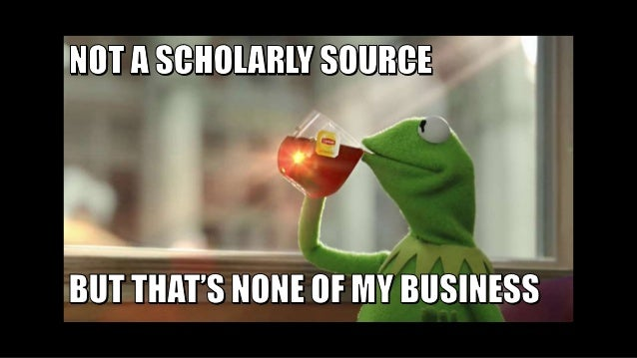
How to enhance your search
For the overachievers in the room
Notes:
Enhancing your search is a great way to make sure that the best results for your query come to the top. No one wants to go through pages and pages of results to try and find something that works.

Slide 11
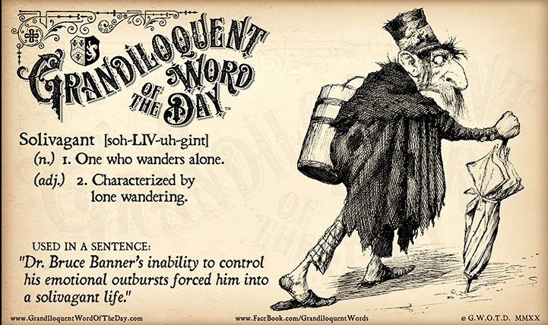
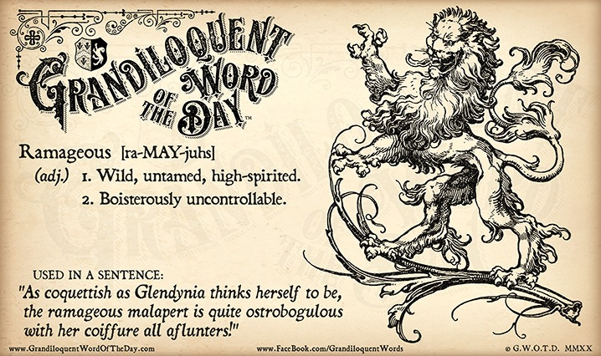
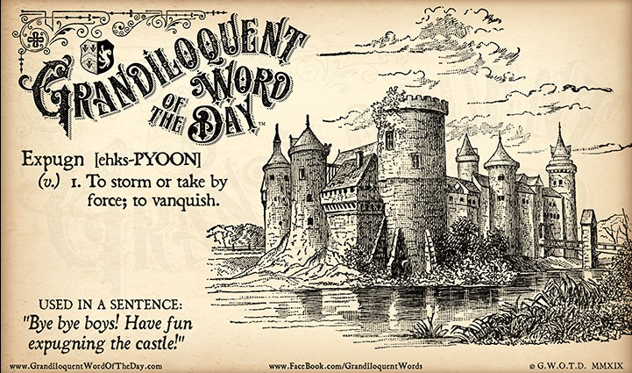
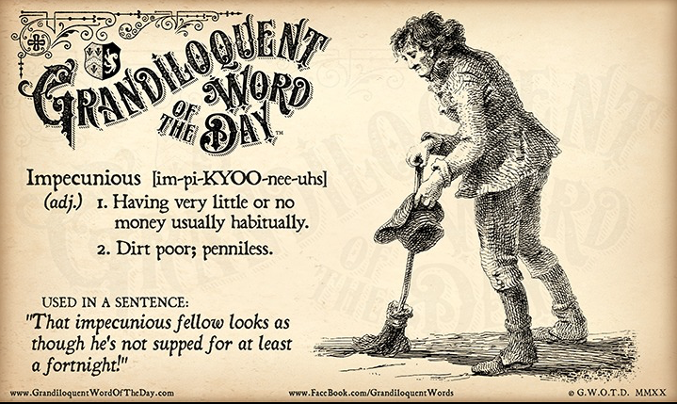
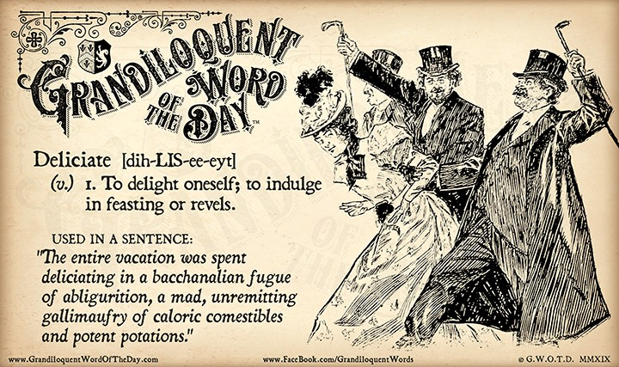
Use Your Big Kid Words
Used with permission
Notes:
I can't stress this enough: You've got to use the big kid words. Every major, program, and profession has its own terminology that is specific to it. This terminology serves as a way of communicating ideas in a direct manner. You need to make friends with these words because they will determine the outcomes of your searches.

Slide 12
Behold the side bar awesomeness
Make sure to click “Full Text”
Select “Scholarly (Peer Reviewed) Journals
Make sure the dates are set to current trends
Check “Academic Journals”
Always click “full text”
This is the research your professors want
Be aware of your research expiration date
Academic journals are safe sources
Notes:
Behold the side bar awesomeness! While it's nice to see that there are over 100,000 search results, there's no way you can sort through all of those articles to find the best ones. This side bar will help you to narrow down your results. By clicking on "full text," you'll have access to the entire article. Click on scholarly (peer reviewed) journals. You'll need to adjust the publication date to one that is acceptable to your program. Each program has an "expiration date" for research that is out of date. If you're in a medical program, you'll need to make sure your research is no older than 3 years. For all other programs, you're looking at five years. Finally, click on the academic journals under source types. This combination of clicked boxes will give you results that your professors would accept as "citable."

Slide 13
Search Result citation info
Notes:
This is what a search result looks like. The yellow is your title. Below it is a citation. This definitely should not be used as your final citation. Style guides vary, and this may not match what your professor is expecting. Business Source Complete in blue is the database that this article is from. The icon on the left indicates that this is from an academic journal, which means that it's scholarly. The PDF Full text in blue is where you download the article.

Slide 14
Article Breakdown
Notes:
This is what it looks like when you click on the article. From here, you can download the article on the left. You can save your article to google drive. We're a gmail school, so you have storage built into your school email. These articles are tiny in size, and they won't take up much space. I recommend saving whatever you even might need into this drive, especially if you’re using our library computers. Besides, you never know when you’ll be able to use those articles again in a future assignment.
At the bottom, you can select the permalink. Any time you need to use a link, you need to use the permalink. Otherwise, you'll only send the link to the search results. The permalink will pop up at the top of the article title. If you don’t select the permalink option, it won’t be there.

Slide 15
Wait! I need more help!
I thought that I was ok, but I’m not.
Notes:
Once again, I’m not going to shame you for coming in at the last minute. Sometimes, you think you’re doing ok. You think you’ve got a handle on things. Then, you dive more deeply into the assignment and realize that you’re in big trouble. Been there. Done that. You have my empathy.

Slide 16
You are the rock star
Unless I am in a meeting, everything stops when you come to my office
Ask for me at the reference desk. They can point out my office.
HOWEVER! You are not required to come to my office in person.
I read your emails as soon as I can.
Your homework hours are not traditional business hours, but I’m limited in the evening
Notes:
When you reach out to me for help, you're the rock star. It can be in person, or through email. When I'm at work, I stop whatever I'm doing to answer research questions. When I'm off duty, I'll still answer emails and send information whenever possible. I might not be as quick or able after hours, but I do give it a try. I love assisting with research, and I'm ready to help.

Slide 17
What if you came to the library for help, and the articles ended up not being useful?
It happens!
Research is a cycle
We will find new articles
It won’t hurt my feelings if those articles didn’t work out
Come back as often as you need
Notes:
It does not hurt my feelings at all if you need more research or a different direction. If what I gave you isn't working out, then I'm happy to do additional research. Research is a cycle, and I respect the cycle. Feel free to reach out as often as you need.

Slide 18
Citing your articles
Plagiarism is sort of a big deal.
Notes:
Plagiarism is a big deal. Citations are a huge part of your paper, and your professors expect that they will be done correctly.

Slide 19
Citations
Cite your sources or face some consequences
Failure to cite is plagiarism
Plagiarism can cause you to fail an assignment or even fail the class
If you’re stuck, I will email you the proper citation format
Credit: Randal Munroe “XKCD”
Notes:
Cite your sources or face some consequences
Failure to cite is plagiarism
Plagiarism can get you kicked out of school.
I know that citations give students quite a bit of anxiety and headache. If you're stuck, you can email me to look over what you have, or I can give instructions for how to cite something. It’s not worth failing the assignment that you put so much effort into.

Slide 20
How would your professor even know…
It’s obvious when you’re synthesizing someone else’s idea into your paper.
You go from sounding like a freshman, to a grad student, and back to a freshman
There are too many factors to try to change to sound like you
You don’t want to have that awkward conversation
Notes:
It’s pretty obvious when you’re plagiarizing. You go from sounding like an undergraduate student, to a professor who likes to walk their terrier in parks during a New England autumn, and then you go back to sounding like an undergraduate student. There are too many factors that you’d have to take into consideration for you to sound like you when you’re stealing (yes, stealing) from someone else. It’s an awkward conversation when you get caught, so do yourself a favor and just cite your sources.

Slide 21
Citation machines
You’re too green in learning citations to know when a machine spits out an error
You need the practice of building citations and learning the form
It’s really easy for experienced citers to see the errors. Your professor has seen hundreds over the course of a semester and have the form memorized
Do. The. Work. The time for machines will come. But not now.
Notes:
Some of you are aware of citation machines. The problem with these machines is that if there’s any deviation in format from traditional articles, these machines act like there’s a glitch in the matrix, and they spit out something wrong. It’s easy for professors to see these errors because, if you remember, they’ve seen a lot of them. You haven’t. You need to learn the form and get it down before you go and mess with a temperamental machine that might get you into trouble with your professors. I see these results all the time from students, and even I know when there’s an error.

Slide 22
Citations done! Right?
I did the things! All of my citations are done, nice and neat, resting comfortably at the end of my paper. All done.
Or not.
Because there are in text citations.
Notes:
In text citations are just as important as the ones you put at the end of your paper. Your professors expect them, and they take them seriously.

Slide 23
Story Time…
Once upon a time, I had a student ask me to check her end references. I was a young, idealistic librarian, full of hope, and I didn’t think to check her in text citations. She failed her paper because she didn’t have any. Her professor informed her that only failing her paper was an act of mercy. She was told that she should have been reported for plagiarism.
The End.
Notes:
Make sure you have those in text citations lined up and ready to go. If you need help, I can help.

Slide 24
Important Note
I don’t expect you to memorize the following slides
They’re there for your benefit if you download the presentation
They act as a reference point or a guide for when you’re actually doing your homework. I’ll show you how to download later.
Here. Have a puppy.
Notes:
Students can easily get confused when they look up how to cite something on the internet. Maybe there’s a conflict from one website to another. Maybe one website uses two variations in the same example, and you’re not quite sure what’s the original format and what’s a new variation. Here are some reference slides that show you all of the variations, but only one at a time. It’s all color coded, and I take into account the most popular things that you access: journal articles and websites.

Slide 25
Journal Articles for the Win!
Notes:
Here we go. Remember, you don’t have to memorize these slides, and I’m going to get through them pretty quickly.

Slide 26
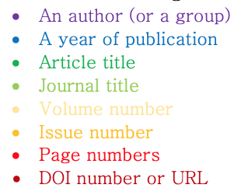
APA Style Guide
You’ve got all the stuff, and this is all where it goes. Tucking in the crazy one comma at a time.
Notes:
If the world were right and good, this is what your citation would look like for a journal article in APA style.

Slide 27
Authors
Notes:
These slide shows you how to handle your author variations

Slide 28
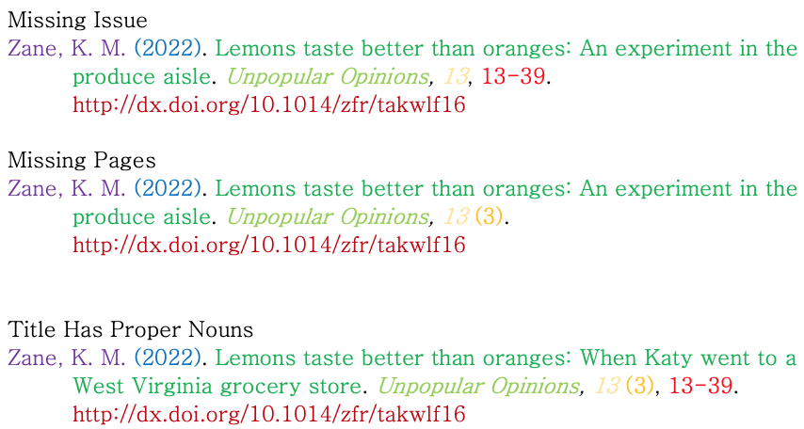
Less than optimal citations
Notes:
This slide shows you how to deal with things that are missing from your article

Slide 29
MLA Styleguide
All your heartburn lined up appropriately.
Notes:
This is the best you could hope for in an MLA journal article. If you found the article through our databases, use the name of the database. If you can’t find the name of the database, you can leave it out. If you got the article online without searching our databases, use the publisher of the journal instead. It might be at the top or bottom of the article. If you need help, just ask.

Slide 30
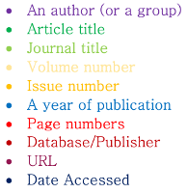
Multiple Authors
Notes:
This slide helps you with author variations

Slide 31
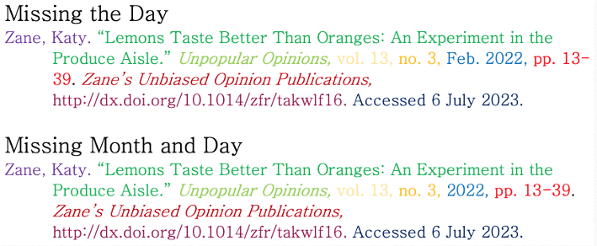
Date Variations
Notes:
Dates are a little tricky with MLA. Sometimes you have the month, and sometimes you only have the year. If you’re not sure if there’s a month, go ahead and just use the year. Don’t spend too much time trying to hunt down a month.

Slide 32
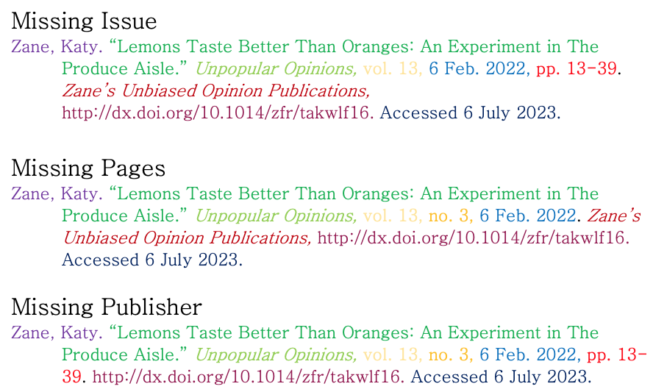
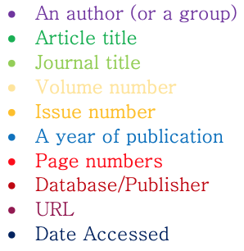
Not the best situation
Notes:
This slide is what happens when things don’t exactly show up the way they should. Somethings are absolutely consistent, and if it’s not on this slide, then you might not be looking in the right place. Send me an email, and I’ll be happy to help.

Slide 33
Websites Are Great!
Notes:
Websites are an awesome source of knowledge, but they can be more difficult to manage citation-wise than journal articles through a database.

Slide 34
APA Style Guide
Notes:
APA is pretty straight forward. This example is if the stars align and everything is included on the page. But we know that usually doesn’t happen.

Slide 35
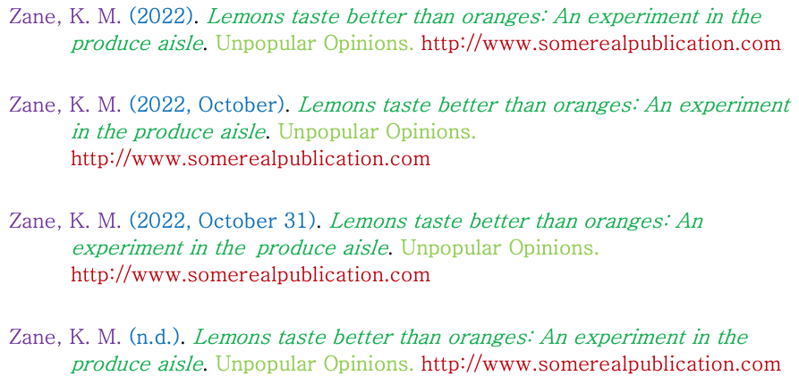
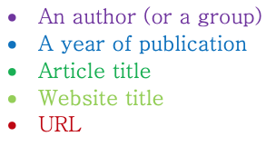
Date Variations
Notes:
Here are all of the date variations that you might encounter. Journal articles are easy. They only want the year. Websites are a different matter though. Anything that you can do to get complete date information is helpful.

Slide 36
Authors and Groups
Notes:
Authors are also a little tricky on websites. Sometimes it’s an individual, sometimes it’s a group, and sometimes there is no author. If there is an author or a group, they tend to be at the top or bottom of the article.

Slide 37
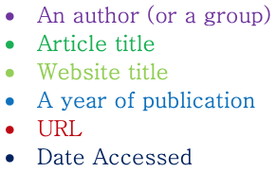
MLA Websites
Optimum Circumstances
Notes:
MLA is very different for how they handle websites, so buckle up.

Slide 38
Disclaimer!
MLA is very…nebulous.
Your professor may have an idea about how to cite that is different from mine.
The safest thing with this style guide is to ask your professor about their expectations.
Even Purdue Owl (the ultimate authority) is evasive in their citation recommendations, and if that doesn’t say something…
But in case it’s midnight and due tomorrow, on that note!
Notes:
Its very…nebulous. There are a lot of moving factors in citing MLA websites. The safest thing to do is to ask your professor how they want their citation to be laid out. However, sometimes time is of the essence, and you need to take your best shot. So, here we go!

Slide 39
Authors…or not
Notes:
These are all of your options for how to cite authors in MLA. Just do your best to find something, anything, that points you to an author.

Slide 40
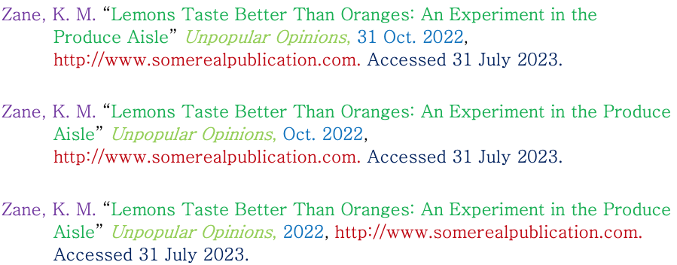
Date Mischief
Notes:
Dates are so difficult. I totally understand. The more you can find about the date, the better. Don’t beat yourself up if you can’t find anything. There are plenty of websites that don’t date their articles at all.

Slide 41
Free samples!
APA in text –
(Author, year, p. page)
(Zane, 2018, p. 3)
MLA in text –
(Author, page)
(Zane 3)
Chicago –
Typically a footnote
Zane admits that candy corn is gross¹
Notes:
Here are your in text citations for your paper. They’re pretty straight forward, but I can still give advice if there’s any problems. I can especially give some guidance about Chicago style. Not many professors use it, but if yours does, I’ll walk you through it.

Slide 42
Purdue owl
This is a fantastic resource for all your citation needs. It goes through several different style guides
If you get stuck, email me
(It’s ok if you get stuck. I get stuck too.)
https://owl.purdue.edu
Notes:
Purdue Owl is a great resource for your citations. It can be confusing sometimes, though. I understand. Don’t be afraid to ask if it’s getting under your skin.

Slide 43
Purdue Owl Homepage
Notes:
This is the Purdue Owl homepage. Simply click on the style guide you need, and it’ll take you right to the citations page.

Slide 44
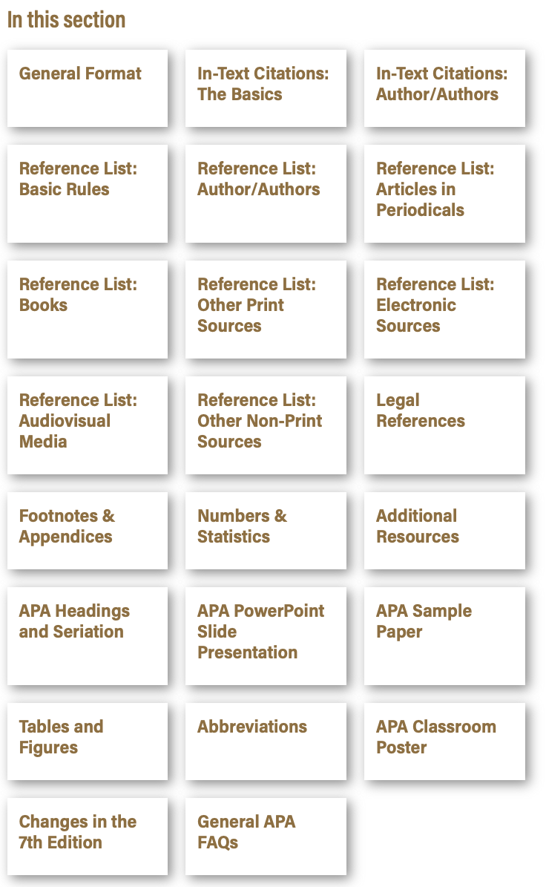
Citation Options
These are all the typical sources that people encounter when they conduct research
If you don’t find what you need, let me know because we may need to Frankenstein something together
Notes:
Here are most of the things that you’ll need to cite. Sometimes a source doesn’t fit neatly into one of these categories, and we may need to Frankenstein something together to make it work.

Slide 45
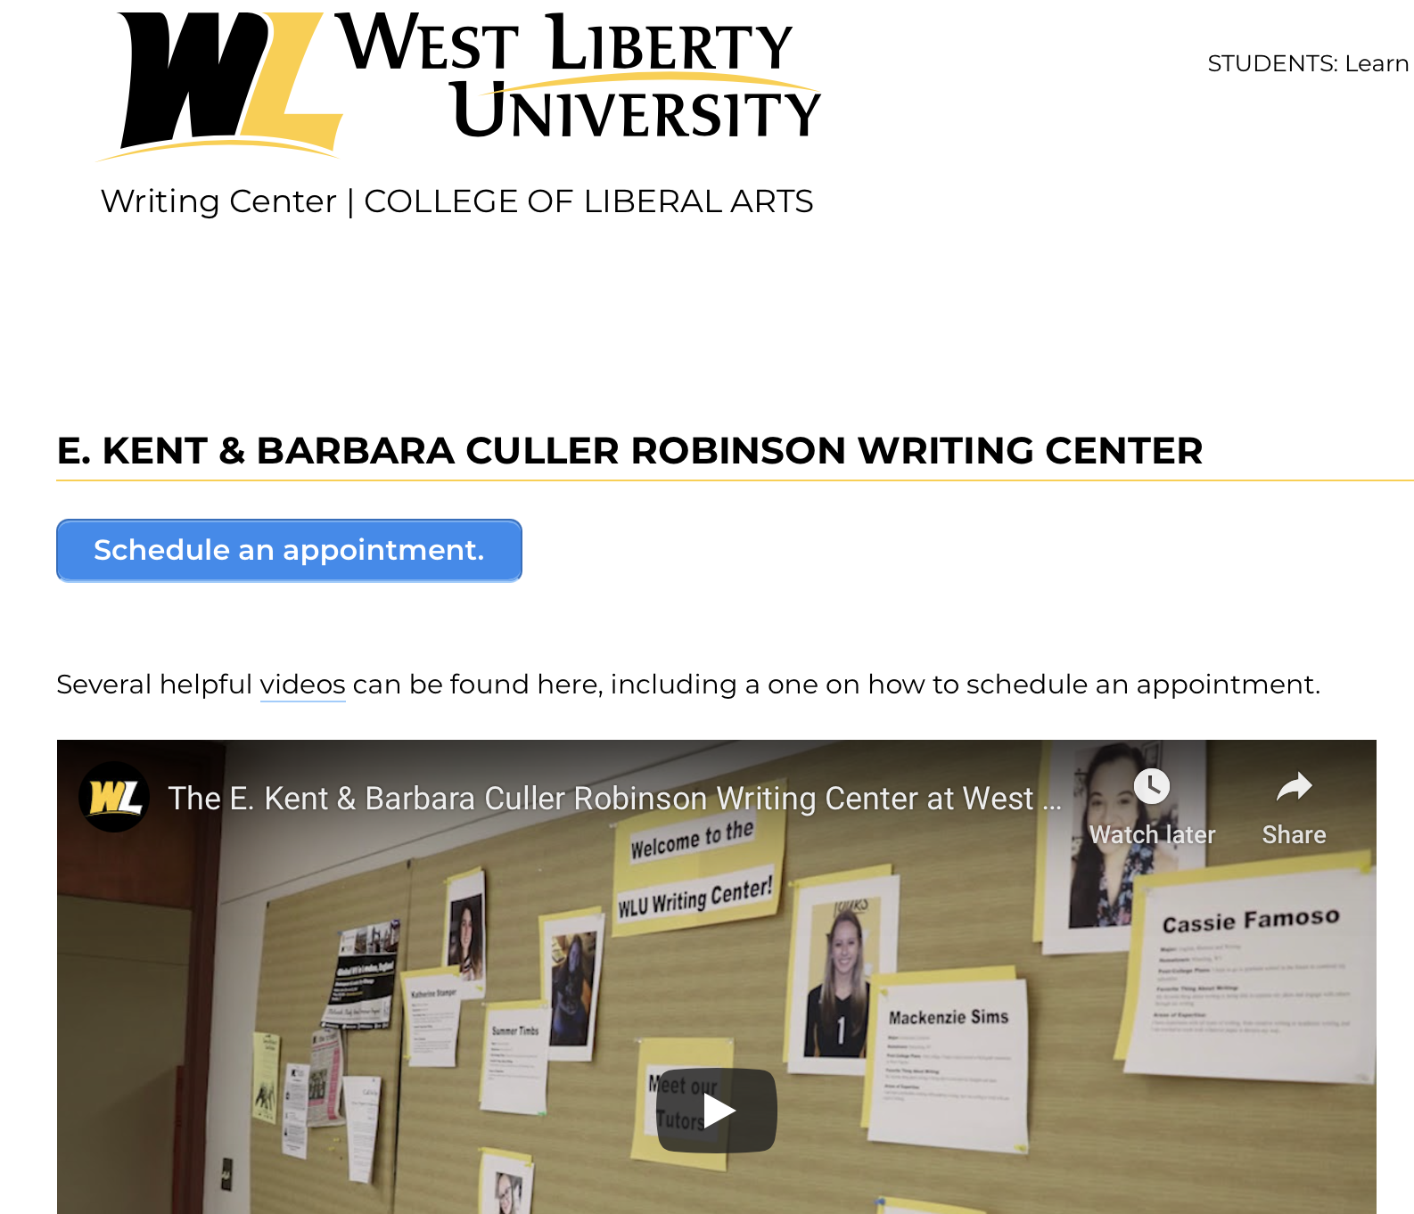
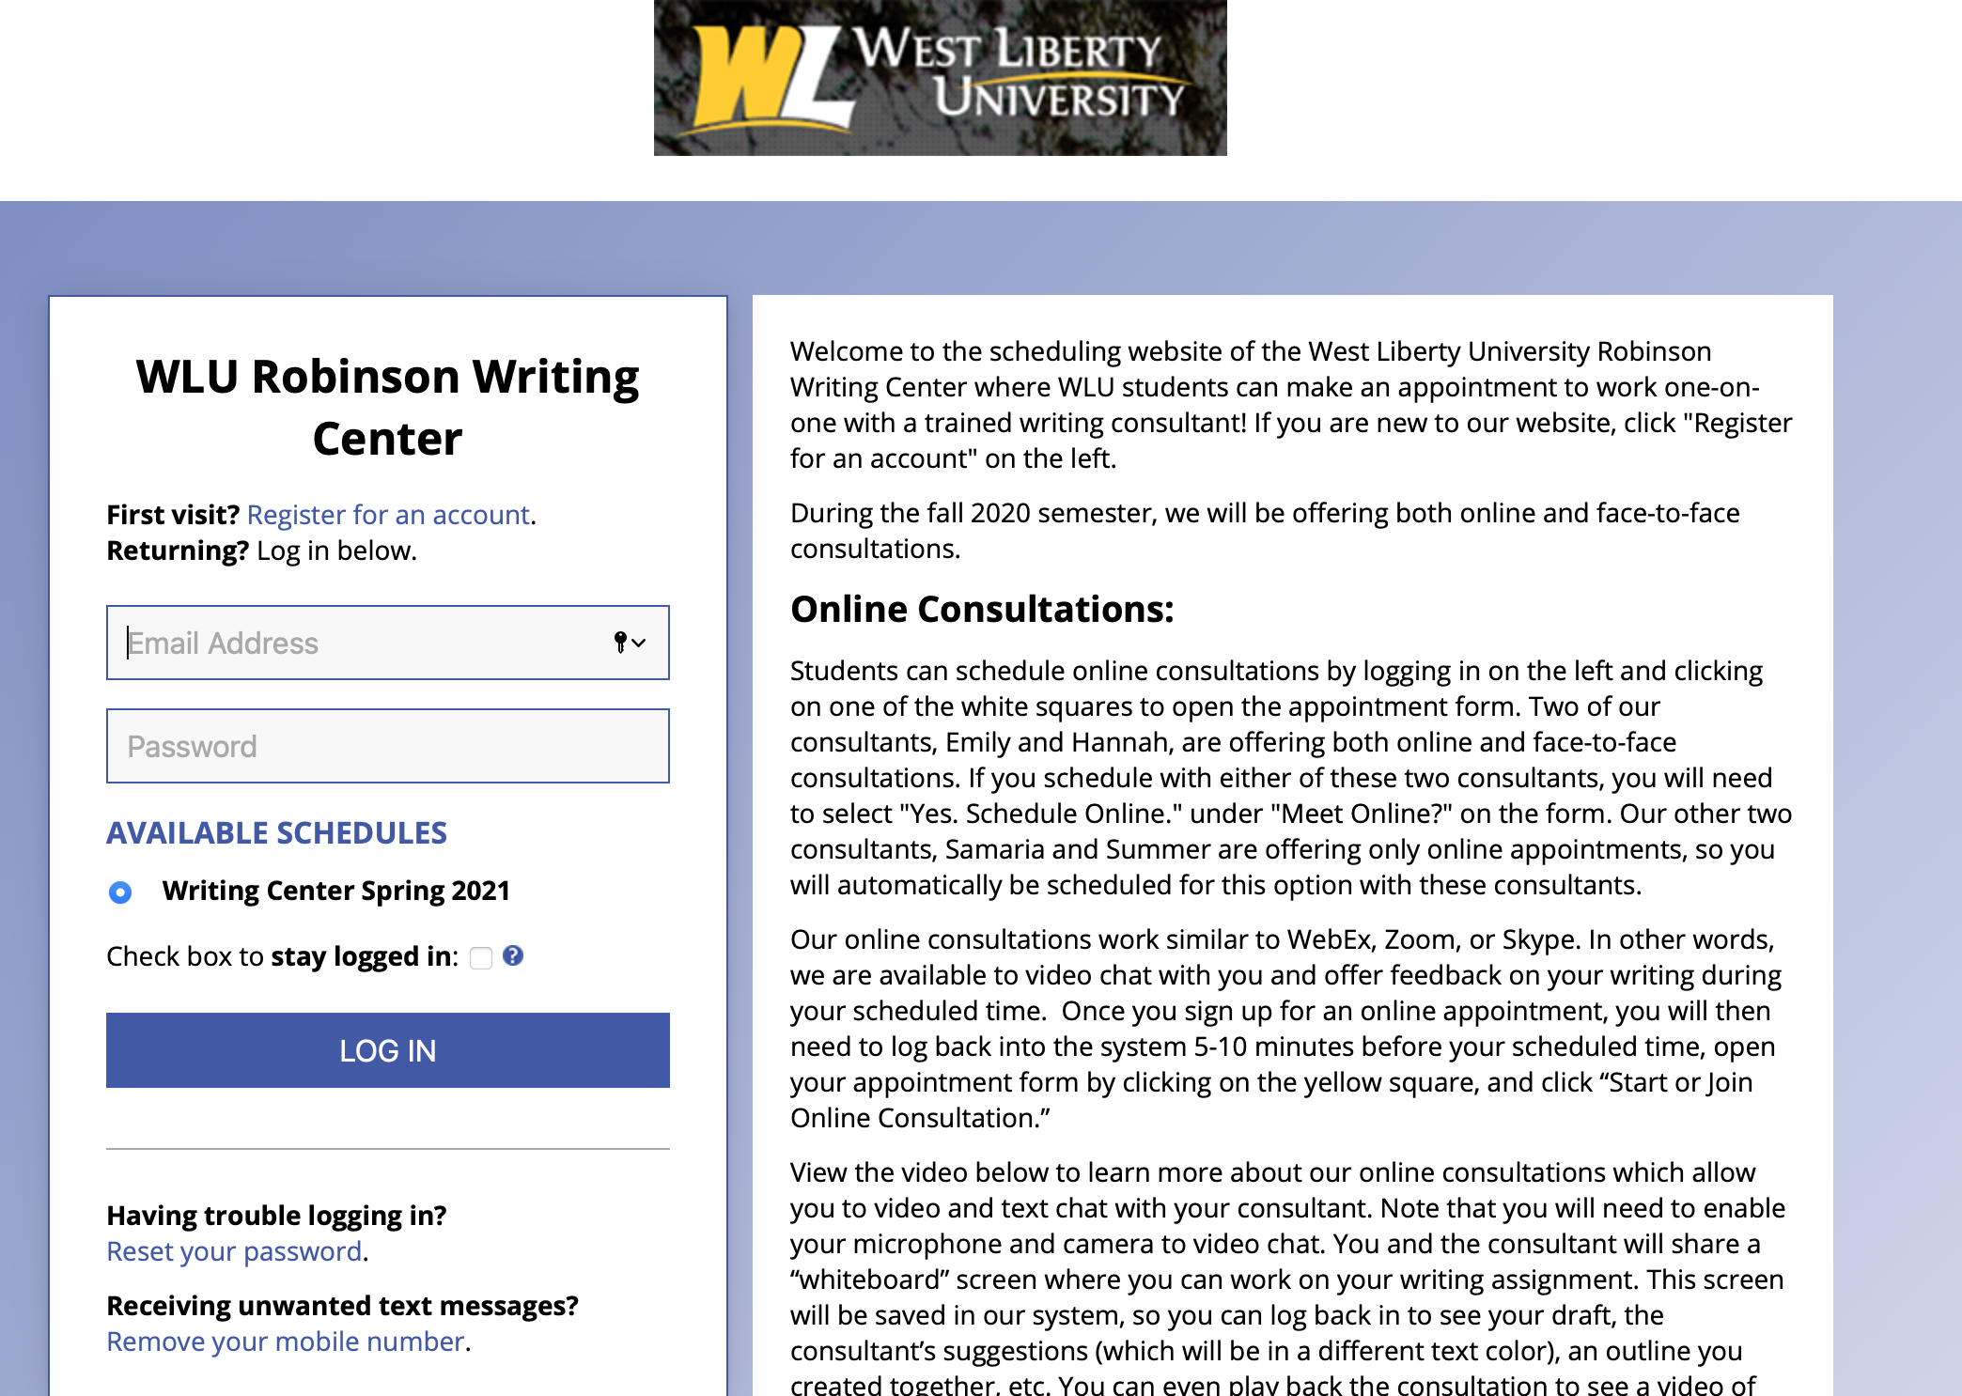
The Writing Lab
This is your best contact for help with your paper.
https://westliberty.edu/writing-center/
On their homepage you can schedule an appointment
They offer both online and face-to-face appointments
Notes:
If you do not feel confident in your writing ability, we do have a writing center. It's located in the basement of the library. You can schedule either digital or face-to-face meetings, and these people are good at what they do. They won’t tell you that your paper is stupid. They are great about pointing you in the right direction without making you feel bad about your efforts.

Slide 46
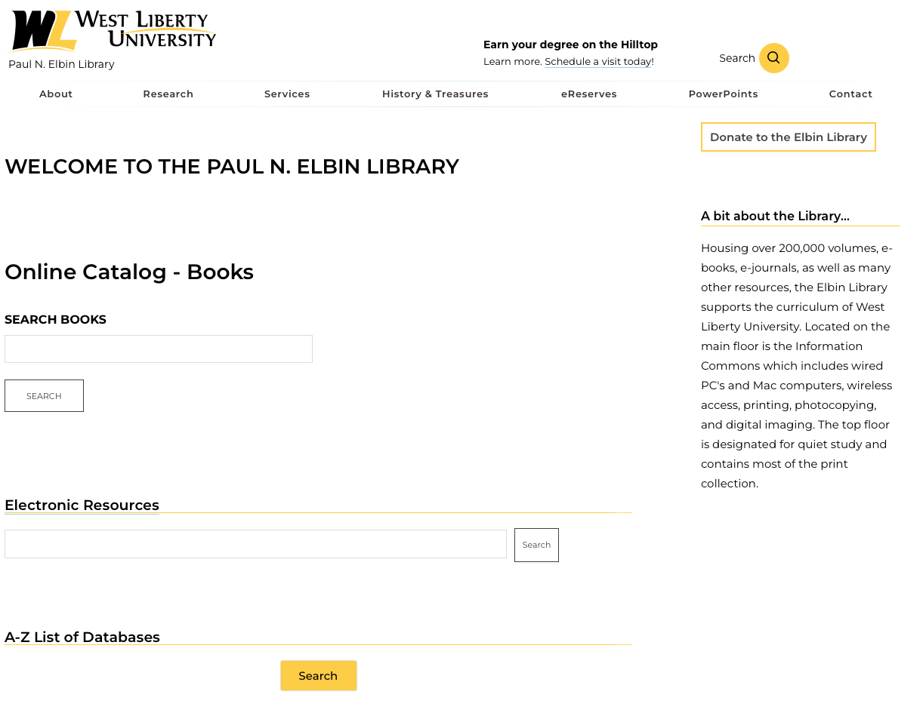
Download this super helpful guide!
Notes:
Obviously, if you’re listening to my dulcet tones, you’ve managed to find your way here.

Slide 47
How to contact me:
You can email me: Katy.zane@westliberty.edu
You can call: 304-336-8534
You can drop by my office. It’s back by the water fountain on the left.
I love reference questions! They make my day.
You are important. You are the most important people that I help.
Notes:
You can use the following methods to contact me. Email is probably the most effective way. I am working on recognizing interpretive dance as a means of communicating your research needs. You’re the most important people that I serve. I’ve worked with professors, university presidents, and I’m a state presenter for the West Virginia Library Association. None of that matters if I can’t help all of you. So, don’t be shy.

Slide 48
Go forward and make me proud
Notes:
Good luck on your future assignments! You can always reach out. You can always ask.

