Slide 1
Collecting and Analyzing Data

Slide 2
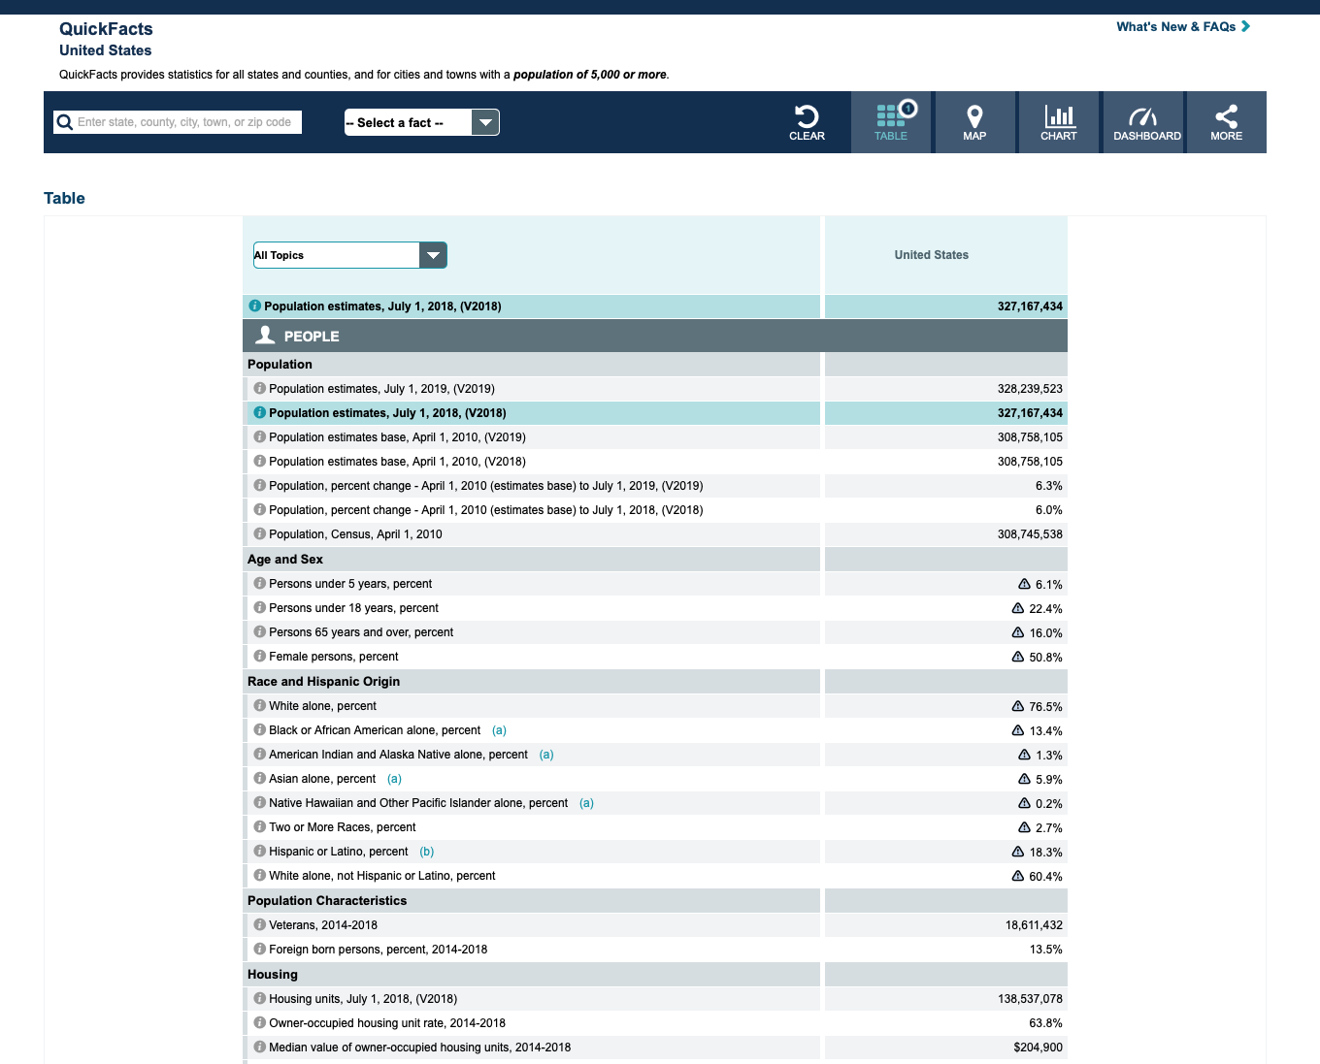
Census Information
https://www.census.gov

Slide 3
Kids Who Count
https://kidswhocount.org

Slide 4
West Virginia Board of Education
https://wvde.us

Slide 5
CASA
https://nationalcasagal.org

Slide 6
West Virginia Adult Education
https://wvde.state.wv.us/abe/

Slide 7
US Department of Education
https://www.ed.gov

Slide 8
WV Info Depot
http://wvinfodepot.org

Slide 9
Pub Med
https://www.ncbi.nlm.nih.gov/pubmed/

Slide 10
ERIC
https://eric.ed.gov

Slide 11
Bureau of Economic Analysis
https://www.bea.gov

Slide 12
Office for National Statistics
https://www.ons.gov.uk

