Slide 1
Student employment
Hiring Manager’s Training
2025 Summer /2025 Fall /2026 Spring

Slide 2
Timeline of Hiring Process
March 2025
Jobs posted in 2024 will be automatically posted/renewed in Handshake by the Student Employment Coordinator.
Hiring Manager completes “New Student Job Position” Form for new student jobs never posted before.
Email will go out to all students to inform them jobs are being posted.
Students can begin to apply in Handshake for jobs.
Student Employment Coordinator monitors student applicants. Will update each Hiring Manager’s spreadsheet to show if a student is Federal Work Study eligible or is Personal Service.
New Federal Work Study eligibility spreadsheets will be created for the 2025-26 Academic Year for each Hiring Manager’s area.
No Later Than April 14, 2025
Hiring managers mark selected students for their posted job as “Declined” or “Hired” in the Pending dropdown menu in Handshake.
Goal: Select as many students as possible to be hired for Summer 2025 by
April 14, 2025.

Slide 3
Timeline of Hiring Process
Returning students who have worked before and are on OASIS payroll:
Student Employment Coordinator will:
Make sure the student is on payroll correctly.
Set up student workers who need to use the timekeeping system with time clocks or on the computer with UKG Pro.
Students who have never worked on campus before:
Student Employment Coordinator will:
Email hired student with instructions to complete their new hire paperwork.
Email both the hiring manager and student with a start date once a student has completed all requirements and is approved to start working.
Ensure that the student creates a myApps account once they are approved on payroll.
Set up student workers who need to use the time clocks or on the computer with UKG Pro.
STUDENTS CANNOT WORK UNTIL A VERIFICATION EMAIL OF APPROVAL IS
RECEIVED FROM THE STUDENT EMPLOYMENT COORDINATOR
Reminder - It can take up to 2 weeks or longer for new or returning student payroll approval.

Slide 4
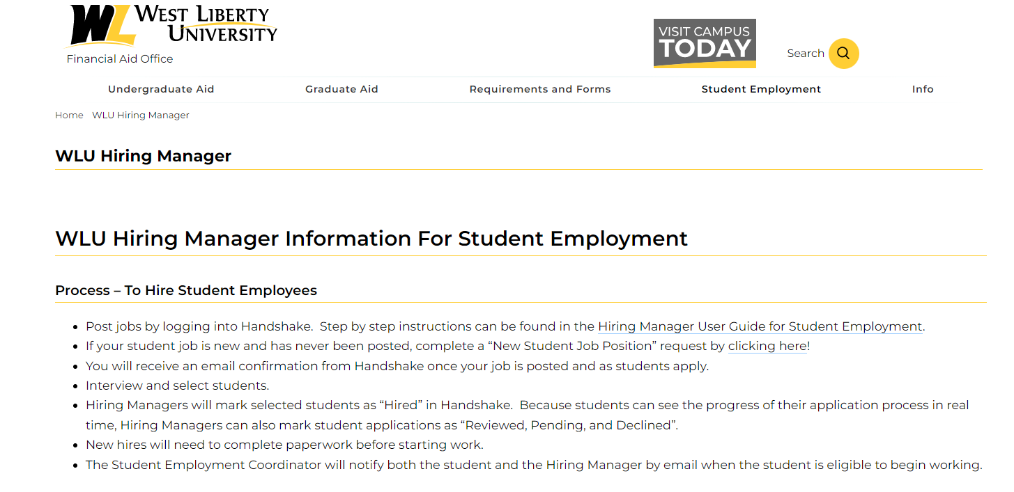
Hiring process for new job postings
Hiring Managers will use the New Student Job Position Form for student jobs that have never been posted.
Click the WLU Hiring Manager button on the Student Employment Website to find the link to complete the New Student Job Position Form.
The Student Employment Coordinator will create a job posting in Handshake based on information listed on the New Student Job Position Form.

Slide 5
IMPORTANT DATES
Summer 2025 May 10, 2025 (first possible date a student can work)
New/Returning Students
Hiring managers need to mark selected student workers as “Hired” in Handshake no later than
April 14, 2025 for students that need to start working by May 10, 2025
Students that need to be hired for August 1 – 11 (such as football, volleyball, soccer, Ambassadors, Graduate Assistants, etc.) should be selected by June 30, 2025.
Fall 2025 August 19, 2025 (first possible date a student can work)
Goal: Select as many students as possible to be hired for Fall 2025 by the end of June 2025
New/Returning Students
Hiring managers need to mark selected student workers as “Hired” in Handshake no later than
June 30, 2025 for students that need to start working by August 19, 2025

Slide 6
Contact and resource information
Sue Garrison, Student Employment Coordinator
Enrollment Services Center
Shaw Hall Room121
sgarrison@westliberty.edu
304.336.8020
New hiring managers:
Instructions will be sent from the Student Employment Coordinator on how to create an account in Handshake. Assistance with learning to navigate Handshake will be available from the Student Employment Coordinator.
WLU Student Employment Website for Students and Hiring Managers
https://westliberty.edu/financial-aid/student-employment/

