Slide 1

Where Does Artificial Intelligence Fit in the Classroom?
Presented by:
Dr. Merilee Madera
Director of Distance Education
West Liberty University

Slide 2

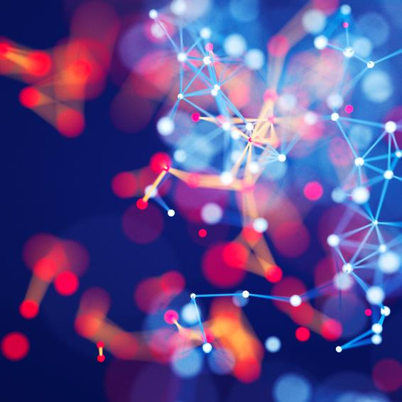

What is artificial intelligence?
“Applications that perform complex tasks that once required human input.” (Oracle Cloud Infrastructure, n.d., para. 1)

Slide 3
Timeline
1936: Alan Turing proposes that a computing machine would be capable of executing cognitive processes, provided they could be broken down into multiple, individual steps and represented by an algorithm.
1943: Artificial neurons were proposed by Warren McCulloch and Walter Pitts.
John McCarthy coined the term artificial intelligence.
The Logic Theorist was presented at the DSRPAI conference by Herbert Simon, Allen Newell, and John Clifford Shaw.
Progress on AI stalled because computers didn’t have enough computational power, databases weren’t large enough, and there was a lack of research funds.
Pre-1950
1950
1956
1966
1970s
Alan Turing published his paper, “Computing Machinery and Intelligence” and introduces the Turing test, which determines a machine's ability to exhibit intelligent behavior equivalent to, or indistinguishable from, that of a human.
Joseph Weizenbaum created the first chatbot, ELIZA.

Slide 4
Timeline
Field reinvigorated with the introduction of expert systems and financial investments such as Japan’s Fifth Generation Computer Project.
2002: Roomba introduces AI to the home.
2006: Amazon starts its cloud computing service.
2007: Apple launches the iPhone.
2009: Google builds the first self-driving car to handle urban conditions.
2022: ChatGPT introduced.
The global chatbot market has an estimated value of $6.92 billion in 2023.
1980s
1990s
2000s
2010s
2020s
1997: IBM’s Deep Blue defeated Gary Kasparov and Dragon Systems introduces Naturally Speaking 1.0 voice recognition software.
2011-2014: Virtual assistants (Siri, Alexa, Google Now, Cortana) are introduced.
2011: Watson wins Jeopardy.
2014: Chatbot Eugene Goostman wins a Turing test

Slide 5
Types of Learning in Artificial Intelligence
Artificial Narrow Intelligence
  Also known as weak AI
  Machines designed to complete very specific actions; unable to independently learn
  Examples: Alexa, ChatGPT, self-driving cars, and Alpha-Go. Almost all the AI-based systems built to date fall into this category.
Artificial General Intelligence
  Also known as strong AI
  Machines designed to learn, think and perform at similar levels to humans
  Considered by many as a threat to human existence
Artificial Superintelligence
  Machines that surpass the knowledge and capabilities of humans
  Still hypothetical

Slide 6
Types of AI Systems
Reactive Machines
  Limited AI that only reacts to different kinds of stimuli based on preprogrammed rules. Does not use memory and thus cannot learn with new data.
  Good for simple classification and pattern recognition tasks
  Can beat humans because it can make calculations much faster
  Examples: Deep Blue, spam filters
Limited Memory
  AI that can use memory to improve over time by being trained with new data, typically through an artificial neural network or other training model.
  Large language models, a type of deep learning algorithm, are considered limited memory artificial intelligence.
  Current state of AI
  Examples: ChatGPT, self-driving cars, virtual assistants (Alexa, Siri, etc.)

Slide 7
Types of AI Systems
Theory of Mind
  AI that can emulate the human mind and has decision-making capabilities equal to that of a human including recognizing and remembering emotions and reacting in social situations as a human would.
  Does not currently exist but research is ongoing into its possibilities.
  Examples: Robots Kismet and Sophia
Self-Awareness
  Ultimate goal for researchers in this field
  A machine that is aware of its own existence and has the intellectual and emotional capabilities of a human.
  Would not need to borrow consciousness from a model. It will know what it wants and what it has to do. Such a machine will be a living creature in itself.
  Considerable ethical debate about this type of AI

Slide 8
Everyday Uses of AI
Photo editing
Biometrics
Search engines
Recommender systems
Grammar checkers
Smart replies
Smart filters
Predictive text
Chatbots
Digital assistants
Smart home devices

Slide 9
Uses of AI in Education
Adaptive learning
Assistive technology
Data and learning analytics
Gamification for enhanced student engagement
Creating assessments
Intelligent tutoring systems
Generating learning materials
Plagiarism detection
Chatbots for enrollment and retention
Grading
Academic research

Slide 10
What is ChatGPT?
A free chatbot developed by OpenAI (November 2022)
Uses a generative pre-trained transformer (GPT-3.5), a type of autoregressive large language model, and has 175 billion parameters.
Some estimate that it was trained on around 45 terabytes of text data (equivalent to one million feet of bookshelf space or a quarter of the entire Library of Congress) and was fine-tuned to follow instructions using a combination of supervised training and reinforcement learning from human feedback (RLHF).
Can input up to 3,000 words of text
ChatGPT Plus (March 2023)
$20 per month
Uses GPT-4 (estimated to have 1 trillion parameters)
Can input up to 25,000 words of text
Accepts visual in addition to text inputs
Both Versions Have a Knowledge Cutoff of September 2021

Slide 11
ChatGPT in Action

Slide 12
Alternatives to ChatGPT
Bard AI (Google)
Grammarly
MagickPen
Bing AI (Microsoft)
Rytr
Chatsonic
Jasper Chat
Perplexity

Slide 13
Paraphrasing Tools
QuillBot
Grammarly
Wordtune
Paraphrase-Online

Slide 14
Image Creation
DALL-E
Canva
starryai
Craiyon

Slide 15
AI Detection
GPTZero (January 2023)
Created by Edward Tian (‘23 Princeton graduate)
It predicts whether a document was written by a large language model, providing predictions on a sentence, paragraph, and document level.
Uses two metrics to estimate the probability that the text was written by AI: perplexity and burstiness
  Perplexity measures the randomness of the word choice and construction of a given sentence
  Burstiness compares perplexity across sentences.
ChatGPT works by predicting the most common next word, so the more random the construction of a text both within and across sentences, the more likely it was written by a human.
Turnitin (April 2023)
Copyleaks
Winston AI
OpenAI

Slide 16
AI Detection – General Notes
Both GPTZero and Turnitin claim a 98% accuracy rate.
Both systems are far more likely to not catch AI writing than falsely classify student work as AI.
Neither company recommends taking action again a student solely on the basis of their report.
It is much harder for systems to detect text written by GPT-4 than previous versions.
It is harder to detect AI writing in shorter works.
  No standard minimum number of words.
    OpenAI requires minimum of 1000 characters
  Rule of thumb is the more words, the more reliable and accurate the detection.
(GPTZero, n.d.; OpenAI, n.d.; Turnitin, n.d.)

Slide 17
Assessment in the Age of AI
Make a policy on AI usage for each of your courses
Create assignments that use AI writing as a starting point
Focus on the process instead of the final product
Incorporate project-based learning scenarios
Use the flipped classroom model
Be specific with your writing prompts
Provide grading rubrics with clear expectations
Spot check sources
Get to know your students’ writing as much as possible
Consider using Ethical AI Use Checklist for Students from Turnitin
Require course-based research
Assign content behind the paywall
Ask students to show and tell
Quiz students on their own work
If possible, have students incorporate recent events

Slide 18
Sample Policies (Colorado State University)
THE PROHIBITIVE STATEMENT
THE USE-WITH-PERMISSION STATEMENT
THE ABDICATION STATEMENT
A Note on AI: Any work written, developed, created, or inspired by artificial intelligence (AI) is considered plagiarism and will not be tolerated. While the ever-changing (and exciting!) new developments with AI will find their place in our workforces and personal lives, in the realm of education and learning, this kind of technology does not belong. This is because the use of AI robs us all of the opportunity to learn from our experiences and from each other, to play with our creative freedoms, to problem-solve, and to contribute our ideas in authentic ways. In a nutshell, college is a place for learning, and this class is specifically a space for learning how to improve our writing. AI simply cannot do that learning for us.
Generally speaking, you are not authorized to use artificial intelligence engines, software, or artwork generating programs (or similar) to produce work for this class EXCEPT on assignments that I have identified and for which you will have received significant guidance on appropriate use of such technologies. I will provide more information about the specific assignment when the time is appropriate in the course. You may not, however, construe this limited use as permission to use these technologies in any other facet of this course.
From this point forward, I will assume that all written work has been co-authored or entirely written by ChatGPT. I will grade such writing as I normally would and your grade will be a reflection of your ability to harness these new technologies as you prepare for your future in a workforce that will increasingly require your proficiency with AI-assisted work.

Slide 19
Other Samples
Temple University
Princeton
  Intellectual honesty is vital to an academic community and for my fair evaluation of your work. All work submitted in this course must be your own, completed in accordance with the University’s academic regulations. You may not engage in unauthorized collaboration or make use of ChatGPT or other AI composition software.
  Students must obtain permission from me before using AI composition software (like ChatGPT) for any assignments in this course. Using these tools without my permission puts your academic integrity at risk.
Texas A&M University
Northwestern University
    Optional Syllabus Statement Regarding AI-generated Content: Any form of cheating, including improper use of content generated by artificial intelligence, constitutes a violation of Northwestern’s academic integrity policy. Turnitin, which is already in use at Northwestern, is expanding its system to include artificial intelligence detection.

Slide 20
The Future of AI
AI will be regarded as one of the technologies that changed history.
Goldman Sachs economists estimate that 300 million full-time jobs worldwide could be automated by the current wave of AI with white collar workers being more affected that manual laborers. (Toh, 2023)
The ethical questions surrounding further AI development need to be addressed.
  Recently, a group of tech leaders including Elon Musk and Steve Wozniak called for a 6-month moratorium on AI development to give companies and regulators time to formulate safeguards to protect society from potential risks of the technology.
AI should be included in digital literacy programs.
  Not only how to use the tools but how to fact check and be critical consumers of information
AI will not replace teachers but allow us to truly personalize learning.

Slide 21
References
Agnihotri, N. (n.d.). What are different types of artificial intelligence? Engineers Garage. https://www.engineersgarage.com/what-are-different-types-of-artificial-intelligence/
Anyoha, R. (2017, August 28). The history of artificial intelligence. Harvard University, Graduate School of Arts and Sciences. https://sitn.hms.harvard.edu/flash/2017/history-artificial-intelligence/
Bello, S. (2021, May 3). 8 examples of artificial intelligence in our everyday lives. EDGY Labs. https://edgy.app/examples-of-artificial-intelligence
Chandy, B. (2023, February 2). Five ways teachers can integrate ChatGPT into their classrooms today. University of Pennsylvania, Graduate School of Education. https://www.gse.upenn.edu/news/educators-playbook/five-ways-teachers-can-integrate-chatgpt-their-classrooms-today
Ferlazzo, L. (2023, January 18). 19 ways to use ChatGPT in your classroom. EducationWeek. https://www.edweek.org/teaching-learning/opinion-19-ways-to-use-chatgpt-in-your-classroom/2023/01
Google Cloud. (n.d.). What is artificial intelligence (AI)? Google. https://cloud.google.com/learn/what-is-artificial-intelligence
GPTZero. (n.d.). What is GPTZero? https://gptzero.me/faq
Hartman-Sigall, J. (2023, January 18). Edward Tian ’23 creates GPTZero, software to detect plagiarism from AI bot ChatGPT. The Daily Princetonian. https://www.dailyprincetonian.com/article/2023/01/edward-tian-gptzero-chatgpt-ai-software-princeton-plagiarism
Javatpoint Services. (n.d.). History of artificial intelligence. https://www.javatpoint.com/history-of-artificial-intelligence
Kelley, K. J. (2023, January 18). Teaching actual student writing in an AI world. Inside Higher Education. https://www.insidehighered.com/advice/2023/01/19/ways-prevent-students-using-ai-tools-their-classes-opinion
Lateef, Z. (2023, March 3). Types of artificial intelligence you should know. Edureka. https://www.edureka.co/blog/types-of-artificial-intelligence/
McKinsey Explainers. (2023, January 19). What is generative AI? McKinsey & Company. https://www.mckinsey.com/featured-insights/mckinsey-explainers/what-is-generative-ai
McMurtrie, B. (2023, March 6). ChatGPT is everywhere: Love it or hate it, academics can’t ignore the already pervasive technology. The Chronicle of Higher Education. https://www.chronicle.com/article/chatgpt-is-already-upending-campus-practices-colleges-are-rushing-to-respond
Office of the Registrar. (n.d.). Syllabus statements. Northwestern University. https://www.registrar.northwestern.edu/faculty-staff/syllabi.html
OpenAI. (n.d.). AI text classifier. https://platform.openai.com/ai-text-classifier
OpenAI. (n.d.). GPT-4 is OpenAI’s most advanced system, producing safer and more useful responses. https://openai.com/product/gpt-4
Oracle Cloud Infrastructure. (n.d.). What is AI? Learn about artificial intelligence. Oracle Corporation. https://www.oracle.com/artificial-intelligence/what-is-ai/

Slide 22
References
Pregowska, A., & Osial, M. (2021, August 17). What is an artificial neural network and why do we need it? Frontiers for Young Minds. https://kids.frontiersin.org/articles/10.3389/frym.2021.560631#:~:text=The%20first%20artificial%20neuron%20was,and%20then%20leaves%20the%20perceptron
Queensland Brain Institute. (n.d.). History of artificial intelligence. The University of Queensland. https://qbi.uq.edu.au/brain/intelligent-machines/history-artificial-intelligence
sarthakhost2.0. (2023, May 22). Chat gpt 4 parameters, how to use GPT 4, chat gpt 4 features, Login and more. sscnr.net.in. https://sscnr.net.in/chat-gpt-4-parameters/
The Institute for Learning and Teaching. (2023, February 22). What should a syllabus statement on AI look like? Colorado State University. https://tilt.colostate.edu/what-should-a-syllabus-statement-on-ai-look-like/
The McGraw Center for Teaching & Learning. (2023, January 25). Guidance on AI/ChatGPT. Princeton University. https://mcgraw.princeton.edu/guidance-aichatgpt
Toh, M. (2023, March 29). 300 million jobs could be affected by latest wave of AI, says Goldman Sachs. CNN. https://www.cnn.com/2023/03/29/tech/chatgpt-ai-automation-jobs-impact-intl-hnk/index.html
Turnitin. (n.d.) AI writing detection capabilities – frequently asked questions. https://www.turnitin.com/products/features/ai-writing-detection/faq
Turnitin. (n.d.). Ethical AI use checklist for students. https://www.turnitin.com/lessons/academic-integrity-in-the-age-of-ai-ethical-ai-use-checklist-for-students
Vivek, S. (2023, March 16). What is ChatGPT-4? Here’s everything you need to know! TICE. https://www.tice.news/know-this/chatgpt-4-open-ai-artificial-intelligence-features-limitations

Slide 23
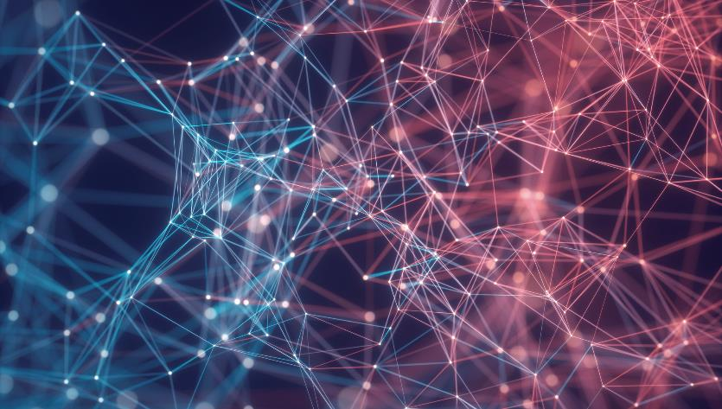

Thank You
Dr. Merilee Madera
merilee.madera@westliberty.edu
(304) 336-8436

