Slide 1
Instructions for accepting financial aid

Slide 2
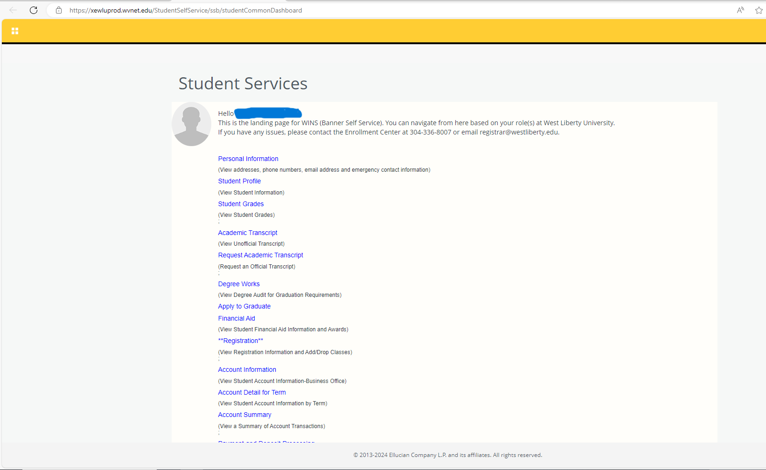
Step 1
Open your West Liberty Student Win’s account.
Your home screen should look similar to this.
Please select the financial aid tab located in the top portion of the page.

Slide 3
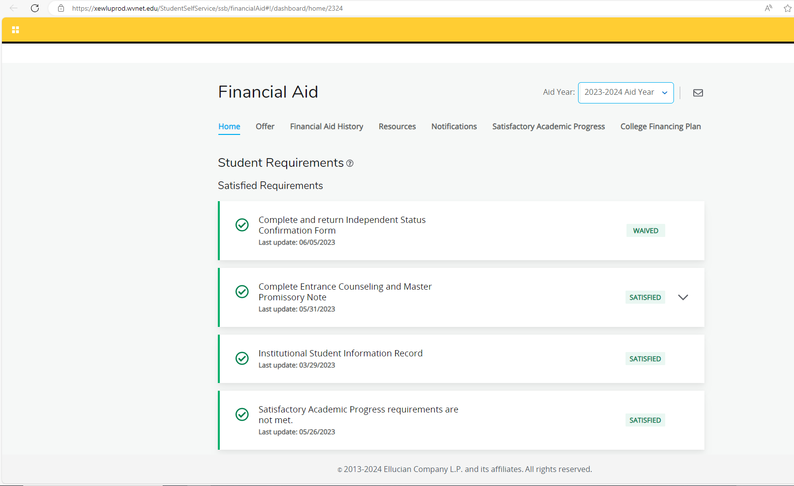
Step 2
Once inside the financial aid portal you will want to locate the offer tab towards the top of the page.

Slide 4
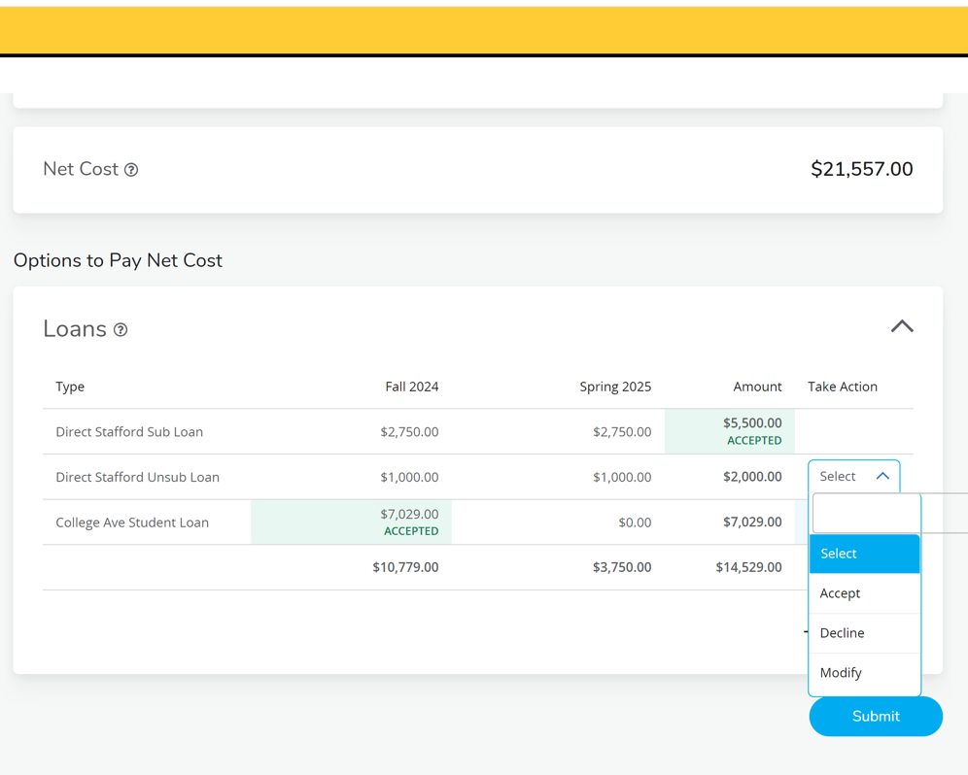
Step 3
You will need to scroll towards the bottom of the page to view your award offers.
Once you have decided to accept or decline those offers you will select the drop down arrow located to the right of the dollar amount

Slide 5
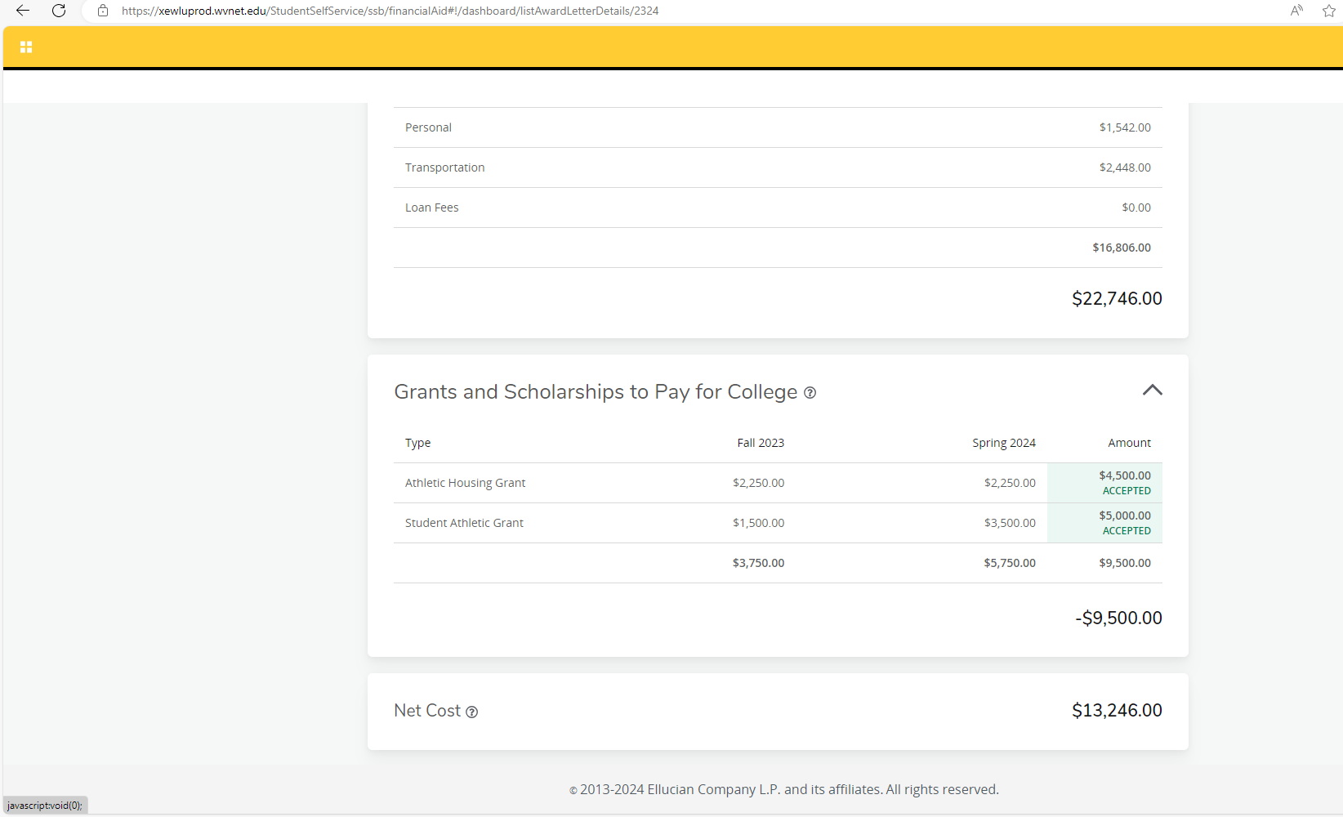
Step 4
Once you have accepted your award offer your screen should look like this.

Slide 6
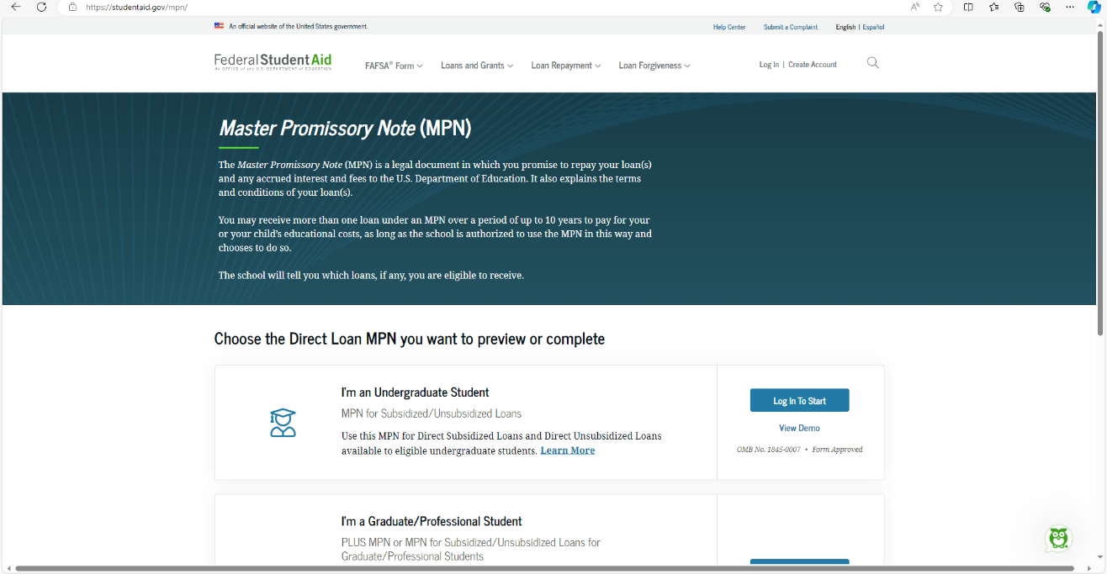
Final step
You will need to contact financial aid to assure that all necessary steps have been completed.
All Federal Loans will require a Master’s Promissory Note to be completed before funds can be awarded.
Completing a Master Promissory Note | Federal Student Aid

