Slide 1
WELCOME TO YOUR FUTURE
Freshman Orientation & Registration - 2018

Slide 2
SCHEDULE OF EVENTS
9:00 a.m. Parent & Student Sessions
11:00 a.m. Meeting with Faculty/Class Schedule Review
12:00 noon Lunch
1:00 p.m. Information Fair-College Union
(Financial Aid, Student Employment, Housing, Dining, Bookstore, United Bank)

Slide 3
ACCEPTED STUDENTS...WHAT’S NEXT?
New Student Information Section at westliberty.edu
Includes important dates and information
for new students

Slide 4
CHANGING ROLES/COMMUNICATING
Students are going to mature and become more independent
Do not pressure students to make home visits
Text/Send Cards
Encourage use of use of campus resources
Stay connected and involved but do not be a “Helicopter Parent” or “Lawnmower Parent”

Slide 5
RULES AND REGULATIONS
Students have a sense of freedom once enrolled
Be clear on your expectations when they return home
Student Policies and Procedures located in the Student Handbook
Academic Policies and Regulations located in the University Catalog
WLU is Tobacco Free

Slide 6
MOTIVATION and CONNECTION
Getting Connected to the University is critical to retention and graduation success
Meet new people/students
Attend Organizational Fair
Attend Residential Hall Programming
Attend Athletic and Cultural Events
Attend Student & Greek Life Events
Participate in Intramurals

Slide 7
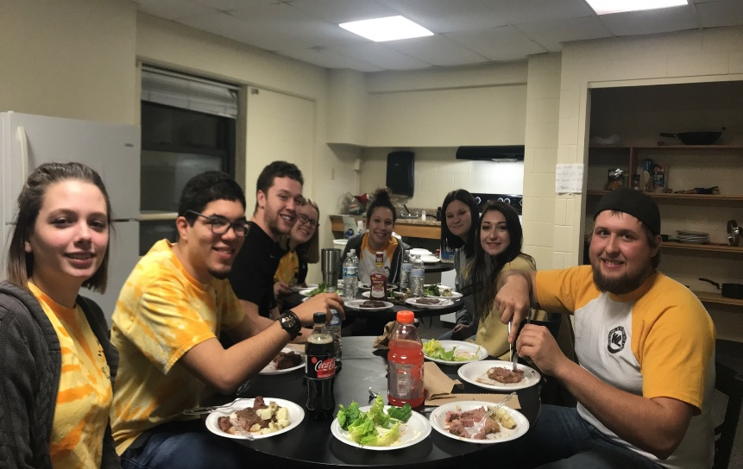
MOTIVATION and CONNECTION
Classes begin on Monday, August 27, 2018
Freshman class schedules are/will be completed
Academic Advisors assigned to assist students

Slide 8
MOTIVATION and CONNECTION
Pre-registration (on-line) for Spring 2019 begins
October 22
Last day to drop a course
with a “W” is November 2
Last day to drop a course
the fall semester is Dec. 7
Contact Enrollment Services
for enrollment verification

Slide 9
FIRST YEAR EXPERIENCE COURSE
Required course for all freshmen
Transition course to help freshmen adjust to college
Topics include: Time Management, study skills, communication, safety, dealing with stress, etc.
It is a graded course

Slide 10
STUDENT COMMUNICATION
All students will have a WLU email account
On line account information available in WINS
TopperNet-emergency text messaging
Twitter
Web Site
DegreeWorks/Topper
Tracks
Information on these available under
“Accepted Students….What’s Next?

Slide 11
GRADES
Mid-term and Final Grades accessed via WINS
Students can repeat a up to 21 credit hours to improve gpa.
Academic Standing (Probation & Suspension)

Slide 12
FERPA
Enrolled students have rights,
WLU cannot release information to a third party without written permission from the student
Parents can ask procedural or general questions
Only directory information can be released
Students can request to have directory information withheld

Slide 13
SAFETY AND HEALTH
24/7 Campus Police Department
Security in residence halls
Student Code of Conduct
Parental follow-up on conduct and responsibility
Discuss healthy habits (eating and sleeping)
Relieving Stress
Department of Health Services, located in Shaw Hall
Mandatory Health Form
Emergency Link
Personal Counseling

Slide 14
BILLING STATEMENTS
Billing statements issued late July
-Emailed to students’ WLU email account
-Release form to add another billing email address (Business Office web page-Student Form)
Statements show balance due or refund due the student
Tuition may differ based on major
Some courses may have additional fees

Slide 15
SATISFACTORY ACADEMIC PROGRESS
For first-time students to have their FEDERAL Financial Aid renewed they must meet the following academic requirements.
-Pass 70% of all coursework attempted.
-GPA require
0 to 29 hours 1.6
30 to 59 hours 1.8
60 or more 2.00
-Any deficit can be made up during the summer
-Students must complete requirements within a 150% maximum time frame

Slide 16
SATISFACTORY ACADEMIC PROGRESS
For students receiving the WV Higher Education Grant or the PHEAA Grant, the renewal requirements are as follows:
-Meet the institution’s Satisfactory Academic Progress
requirements
-Must pass at least 24 credit hours during the fall & spring semesters
-Have at least a 2.0 accumulative GPA
-Deficit CANNOT be made up during the summer

Slide 17
SATISFACTORY ACADEMIC PROGRESS
WV PROMISE recipients who are first time students
must meet the following requirements to have the PROMISE renewed:
-Pass at least 30 credit hours during the fall & spring semesters
-Attain at least a 2.75 accumulative GPA
-College coursework completed during high school or prior to college enrollment CANNOT be considered
Academic Scholarship renewal requirements are listed on the student scholarship agreement (typically a 3.25
gpa and completing 30 hours)

Slide 18
TARGET: GRADUATION!

Slide 19
SCHEDULE OF EVENTS
9:00 a.m. Parent & Student Sessions
11:00 a.m. Meeting with Faculty/Class Schedule Review
12:00 noon Lunch
1:00 p.m. Information Fair-College Union
(Financial Aid, Student Employment, Housing, Dining, Bookstore, United Bank)

Slide 20
GRADUATION REQUIREMENTS
General requirements – 2.00 minimum gpa and a minimum 120 credit hours (a few programs require 128 or more)
Some programs have higher gpa and credit hour requirements
Credit hour requirements include; general studies courses, major courses and elective courses based on major (as listed in the University Catalog)
TopperTracks (DegreeWorks) now available

Slide 21
ACADEMIC ADVISING
Toppertracks Degree Audit System
Advising tool for monitoring
progress toward graduation
What-if analysis
GPA Calculator
All students will have an
academic advisor from his/her
major degree field

Slide 22
LEARNING AND STUDENT DEVELOPMENT CENTER
Offers peer tutoring to students, free of charge
Provides accessibility accommodations
Provides Career Services to graduating students
Academic Probation Remediation

Slide 23
PARENT POWER
Parent Power is a bulletin
designed to keep parents
informed
Includes important dates,
deadlines, and topics
Parent Power is on Facebook
The Facebook page allows for
interactive communication
between parents

Slide 24
Academic Probation
College 103 - Offered each year in the Spring Semester for first year students placed on probation
Students are placed on probation if gpa falls below 2.00
Academic Coaching, intensive advising
Mandatory tutoring

Slide 25
HOUSING
Students have access to roommate information via WINS
81% of first-time freshmen and 50% of all students live in campus housing
All students pay cable/internet fee and residence hall capital fees

Slide 26
Dining Services
Students can choose a weekly 19 meal, 14 meal or 12 meal plan (cost is the same-flexible Sodexo dollars)
Meal changes can be made during first two weeks of the semester
Topper Card serves as Meal Card/Secure Access Card

Slide 27
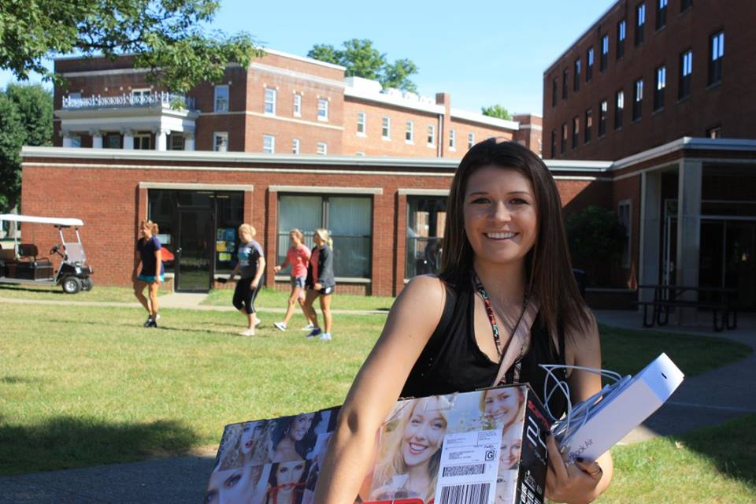
MOVE IN WEEKEND
Residence Halls open for new students on Friday, August 24, at 10:00 a.m.
Extended office hours first week of classes
Enrollment Center – One Stop Shop
Pick up Parking Tag
TopperFest Begins
Family Picnic

Slide 28
Title IX
Protects students, staff and faculty at institutions receiving Federal funding
If an institution knows (or reasonably should know) about sexual harassment, including sexual assault,
that creates a hostile environment, Title IX requires the
institution to take immediate action to eliminate the
harassment, prevent its recurrence, and address its
effects

Slide 29
Student Life
Intramurals
Clubs & Organizations
Greek Life
Wellness Center
Campus Activities
Commuter Services

Slide 30
COMMUTER STUDENTS
Student Union for Food Options and Study Areas
Library and Learning & Student Development Center
for additional study areas
Meal Plans: 5 per week or 50 per semester
Parking
Important to be involved and get connected
Topperfest is for you too!

Slide 31
Questions
Financial Aid: (304) 336-8016
Housing & Student Life: (304) 336-8345
Admissions: (304) 336-8076
Toll Free 1-866- WEST LIB
WestLiberty.edu

